Slide 1
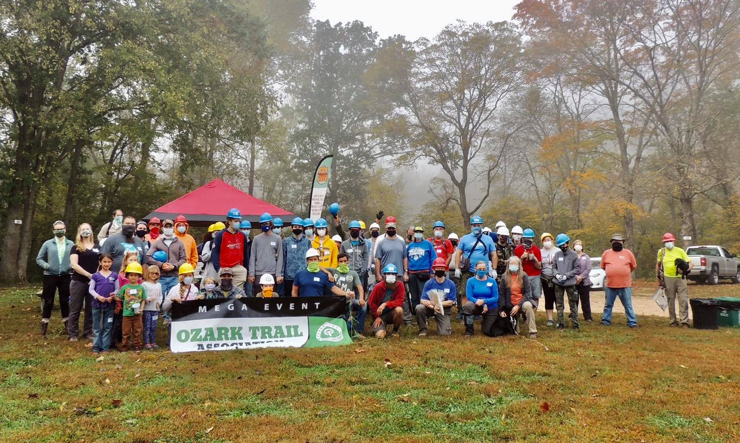
OTA
Construction and Maintenance
2026 OTA Member Update
C&M Committee:
Michael Pearce, Chair
Presenter:
Terry Hawn

Slide 2

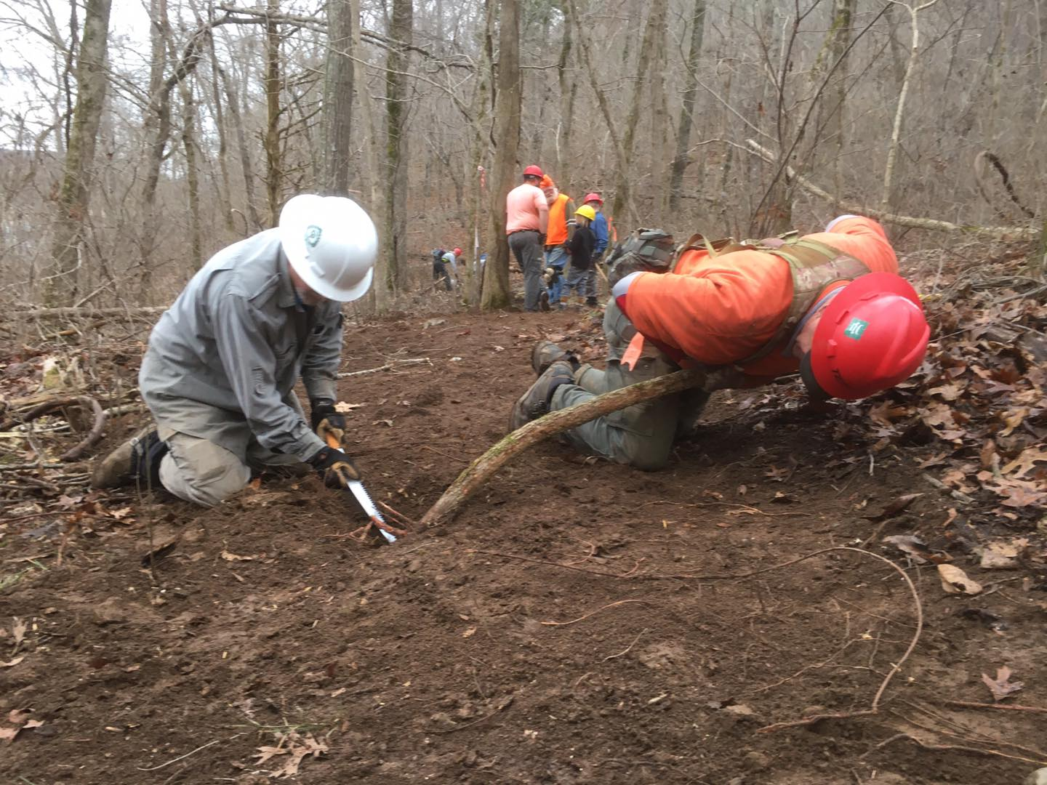
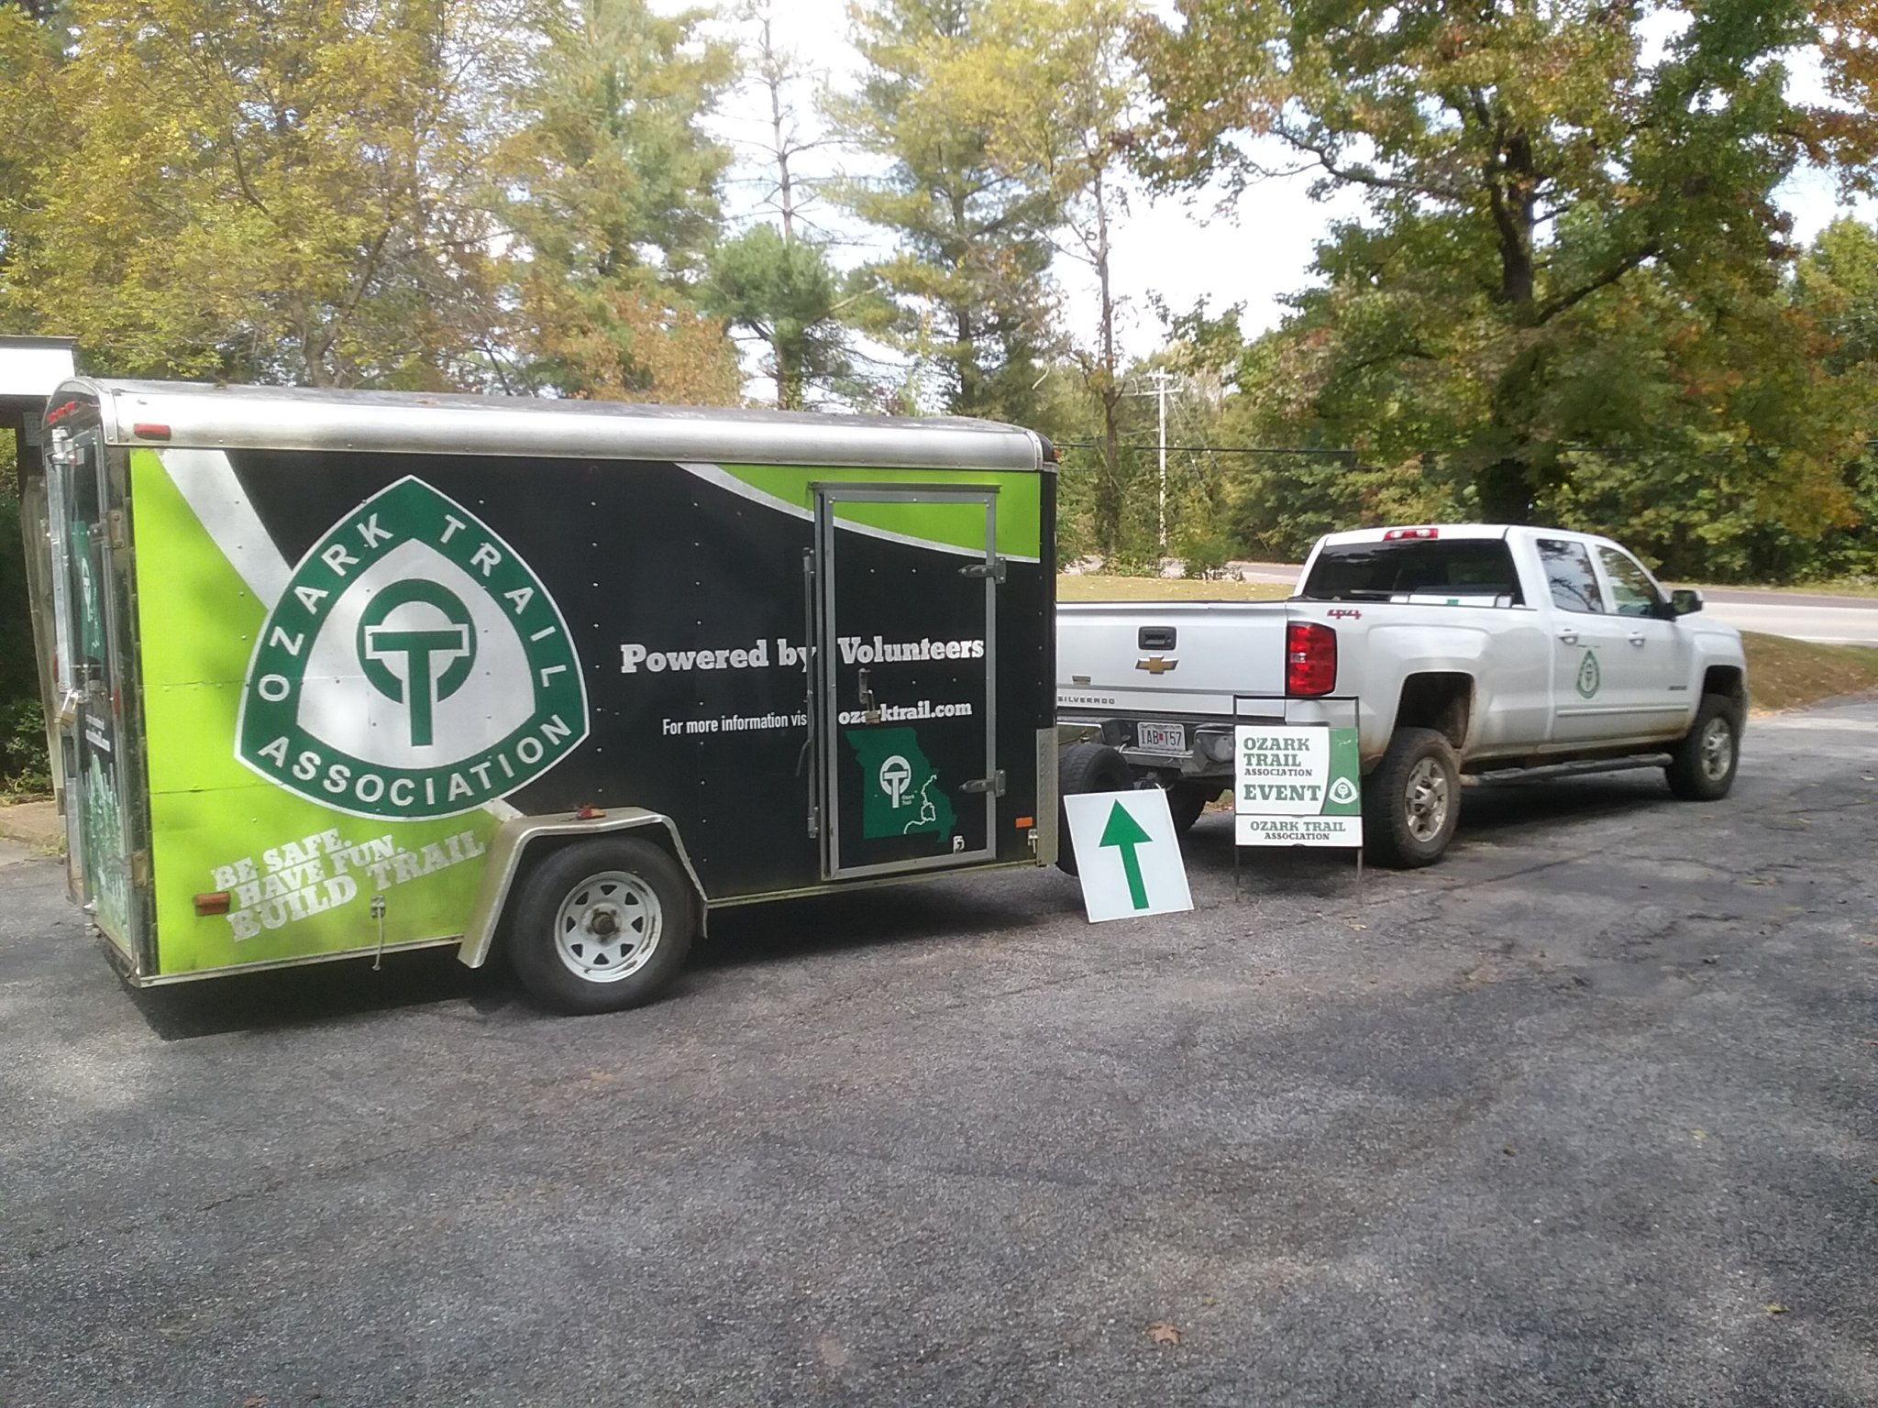
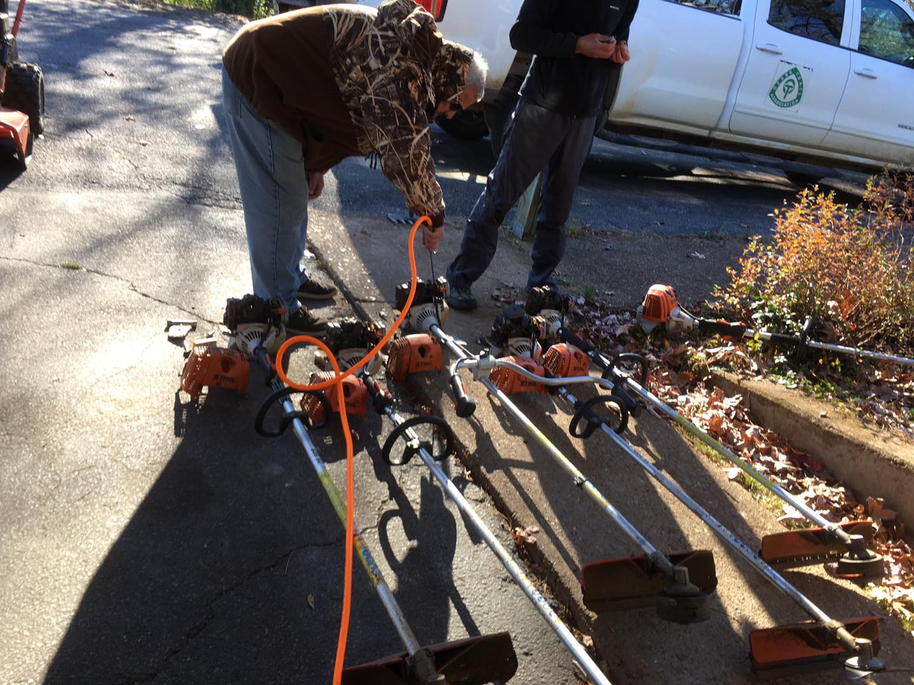
OTA
Construction and Maintenance
Schedules and manages all construction and maintenance events. Recommends specific projects, maintains tools and equipment.

Slide 3
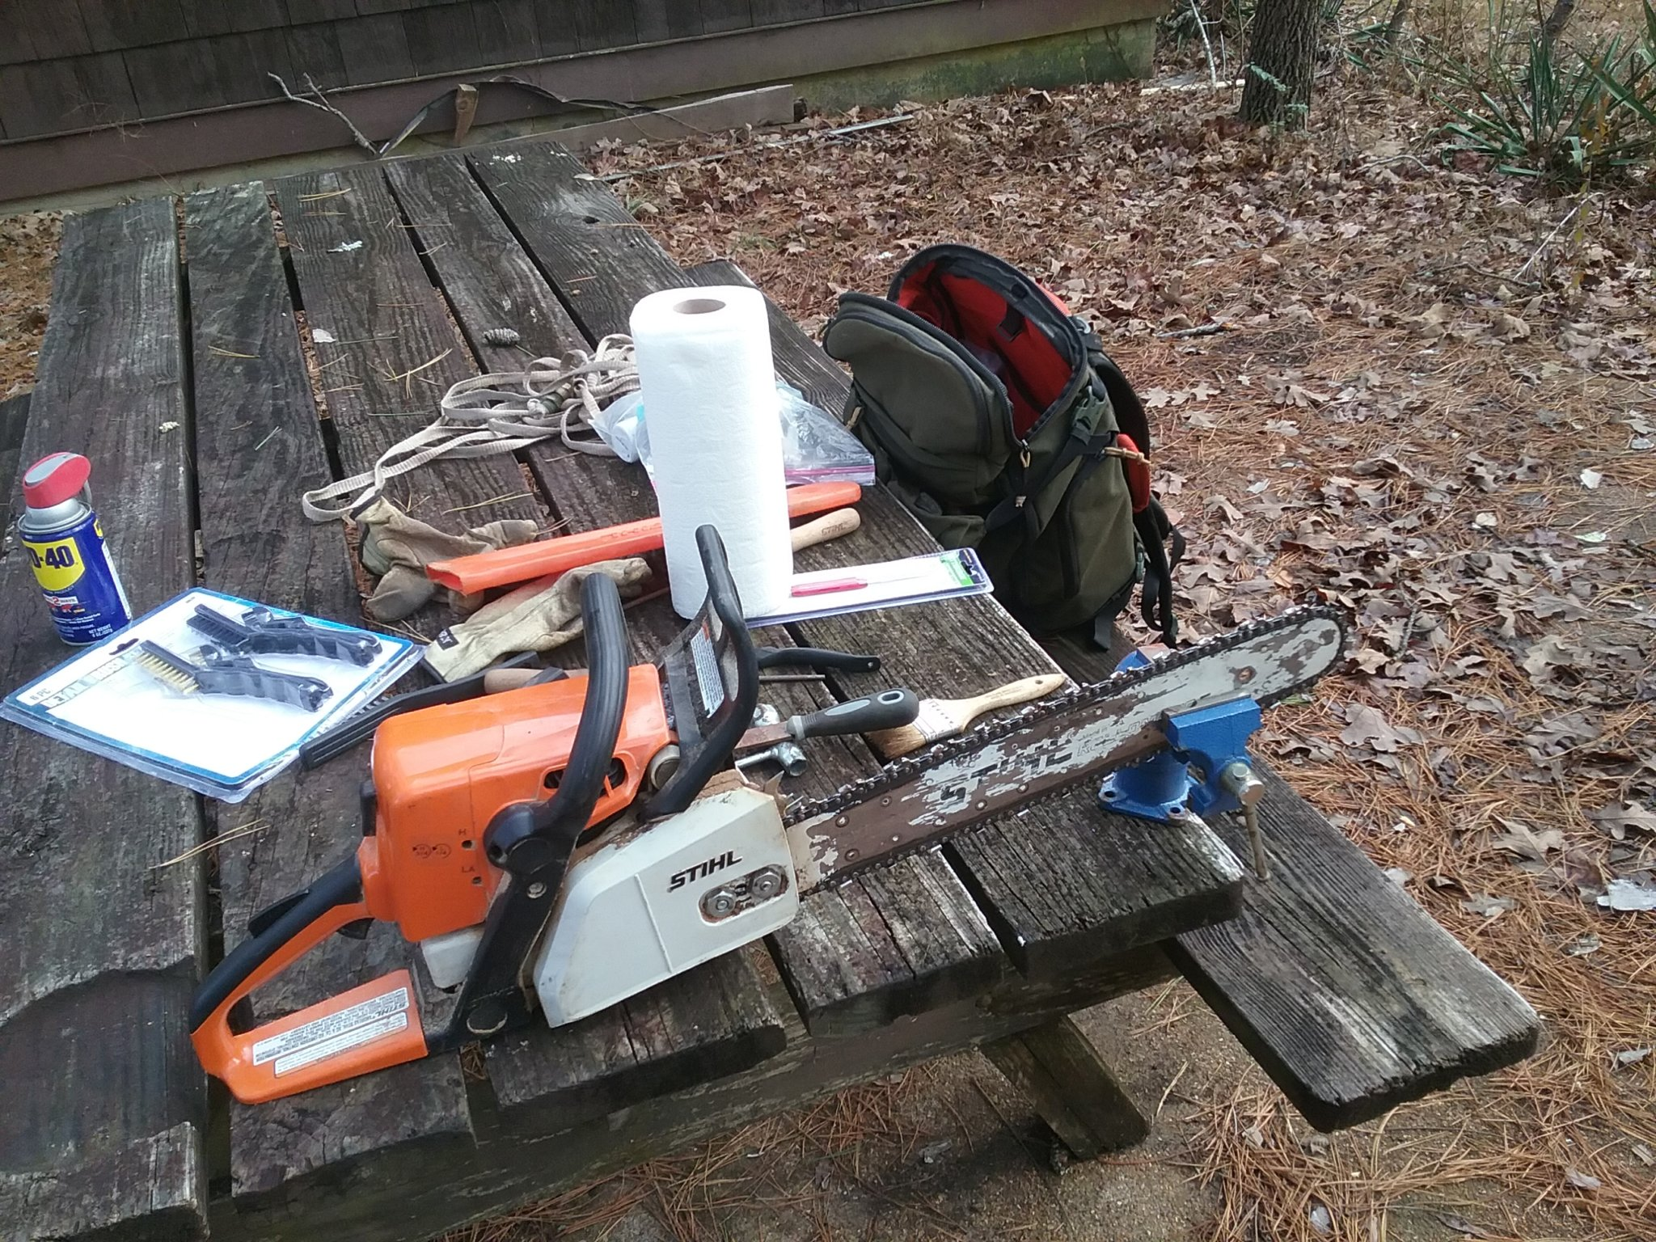
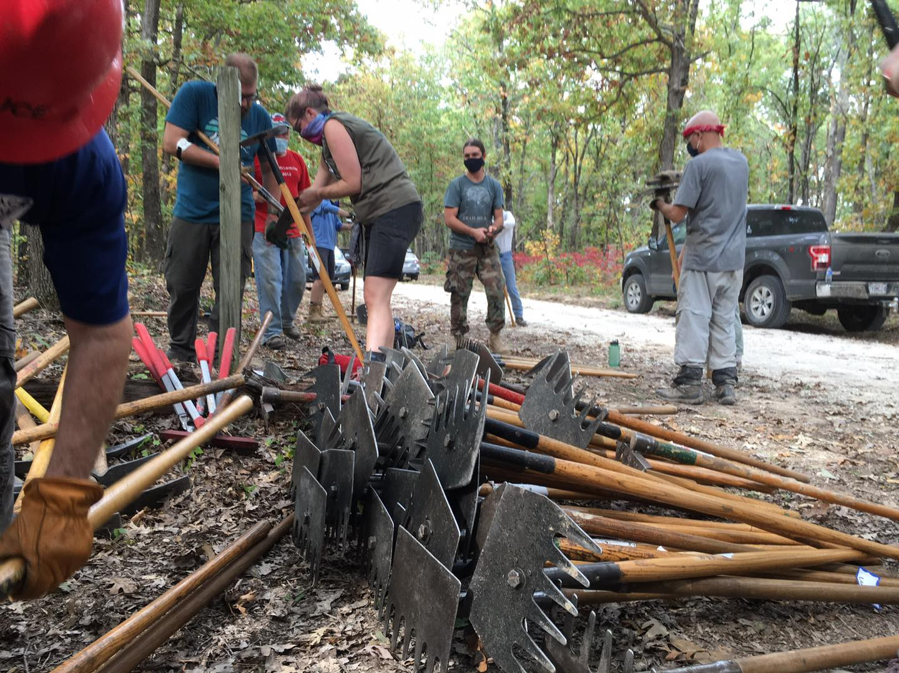
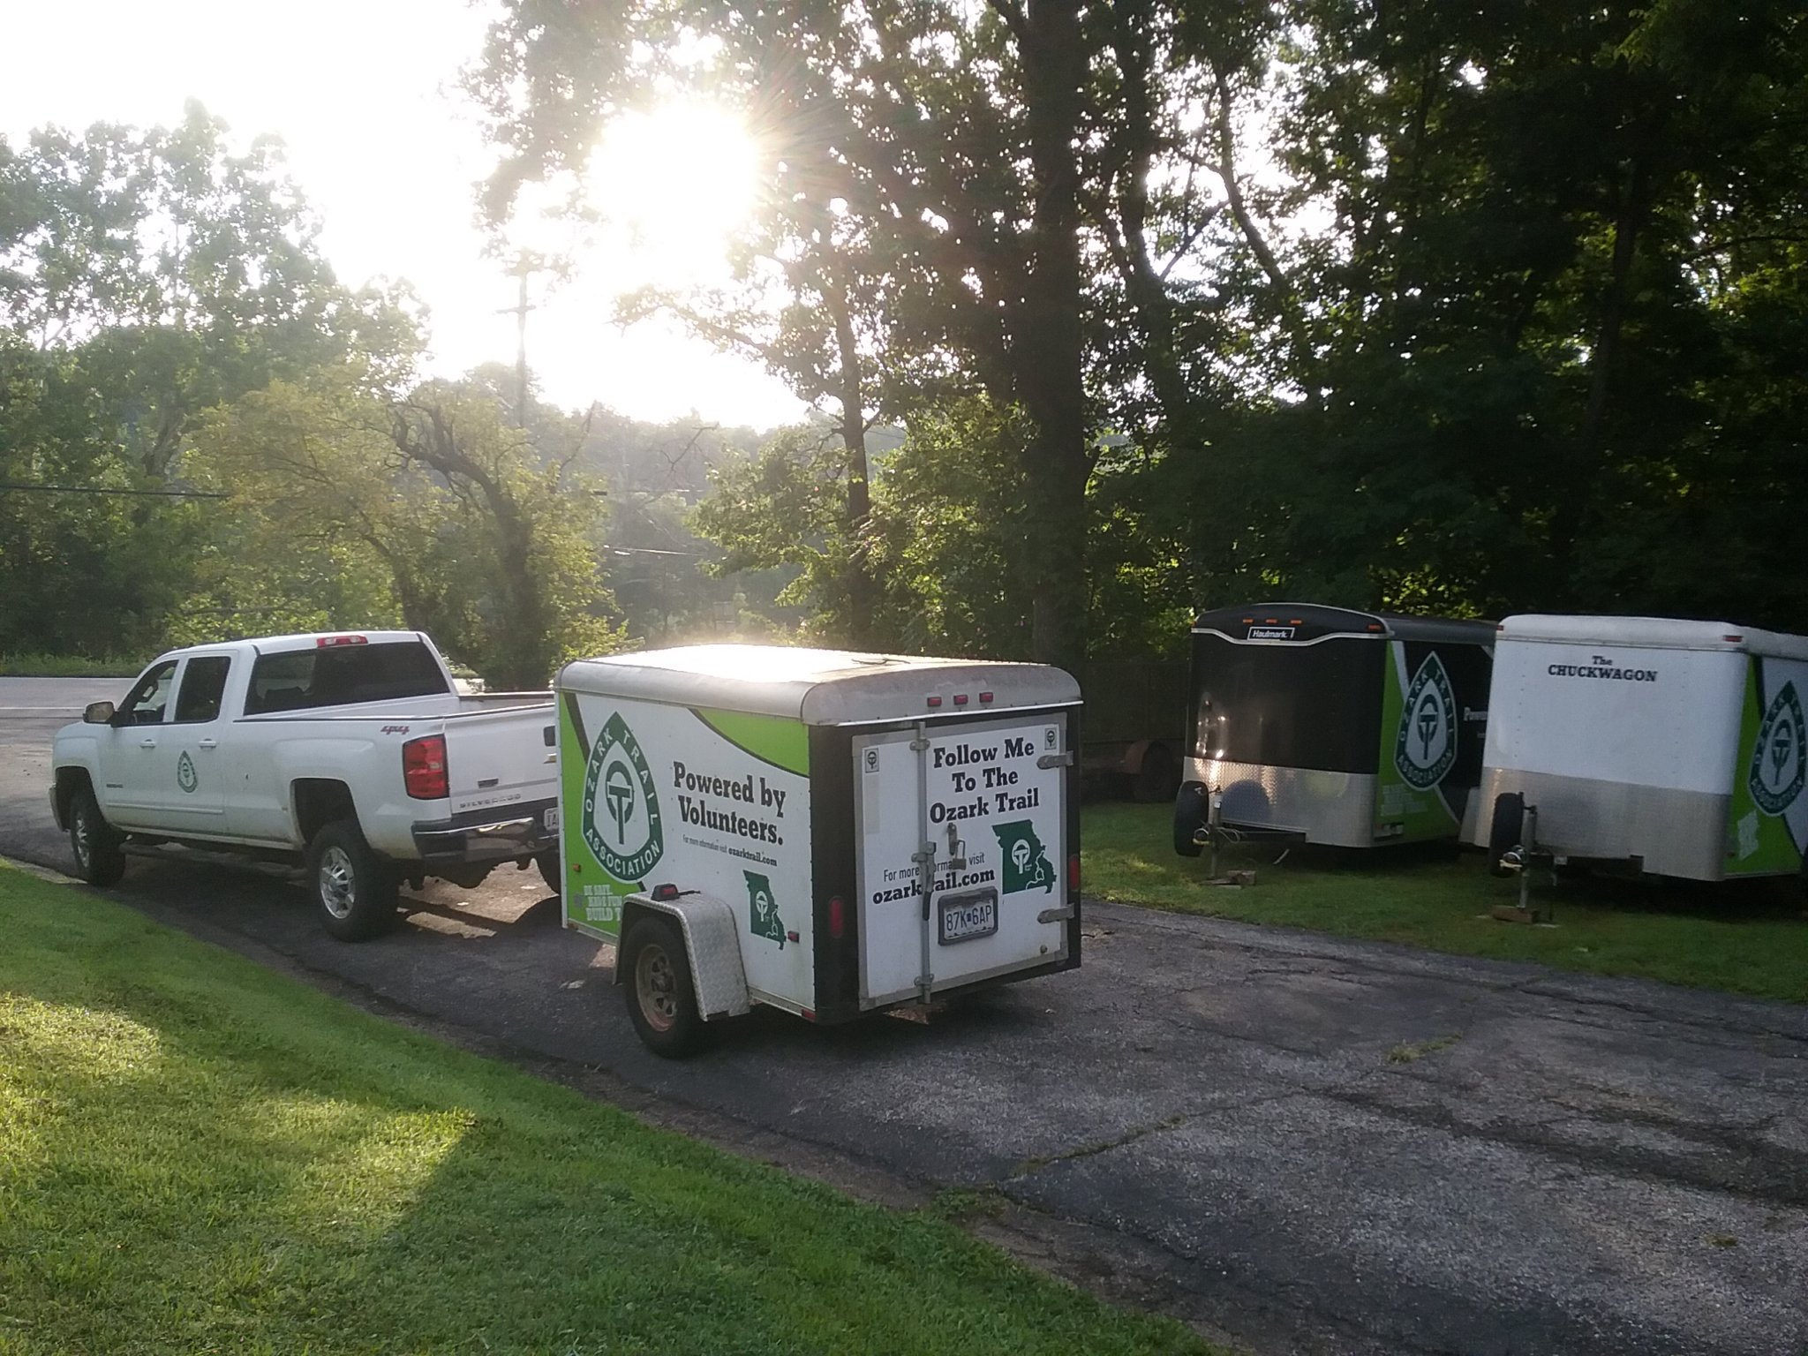
OTA
Equipment & Tools
-Tool cleaning, sharpening, repair
-Vehicle, UTV, ATV and trailer maintenance
-Power tool maintenance

Slide 4
OTA
2025 – Construction/Maintenance
Accomplishments / Goals
Accomplishments
- Completed 8.5 miles of tread rehab across 10 sections of the OT
(Courtois, Trace Creek, Karkaghne, Blair Creek, Current River, Between the Rivers, 11 PT, Marble Creek, Victory. Northfork)
- Completed general maintenance across every section
- Completed 30 events plus 6 – Americorps Crew outings
- Completed 33 USFS Sawyer certifications
- Extended OTA GAOA Crew Leader
- Started work on extending new 11 Pt Western TH to Banner Rd ( CTY RD 430)
Goals (2026)
- Complete another 7.5 miles or more of tread rehab across all sections
- Continue working on 11 PT Western TH extension – 2026 completion
- Participate in Opening of Big Springs new Facilities
- Begin planning of Marble Creek extension to Ketcherside Mtn and Hwy 21
- Get 4th Edition of Trail Guide completed
-5 Americorps Crews scheduled Spring 2026
  ( 2 complete – 3 more scheduled)

Slide 5
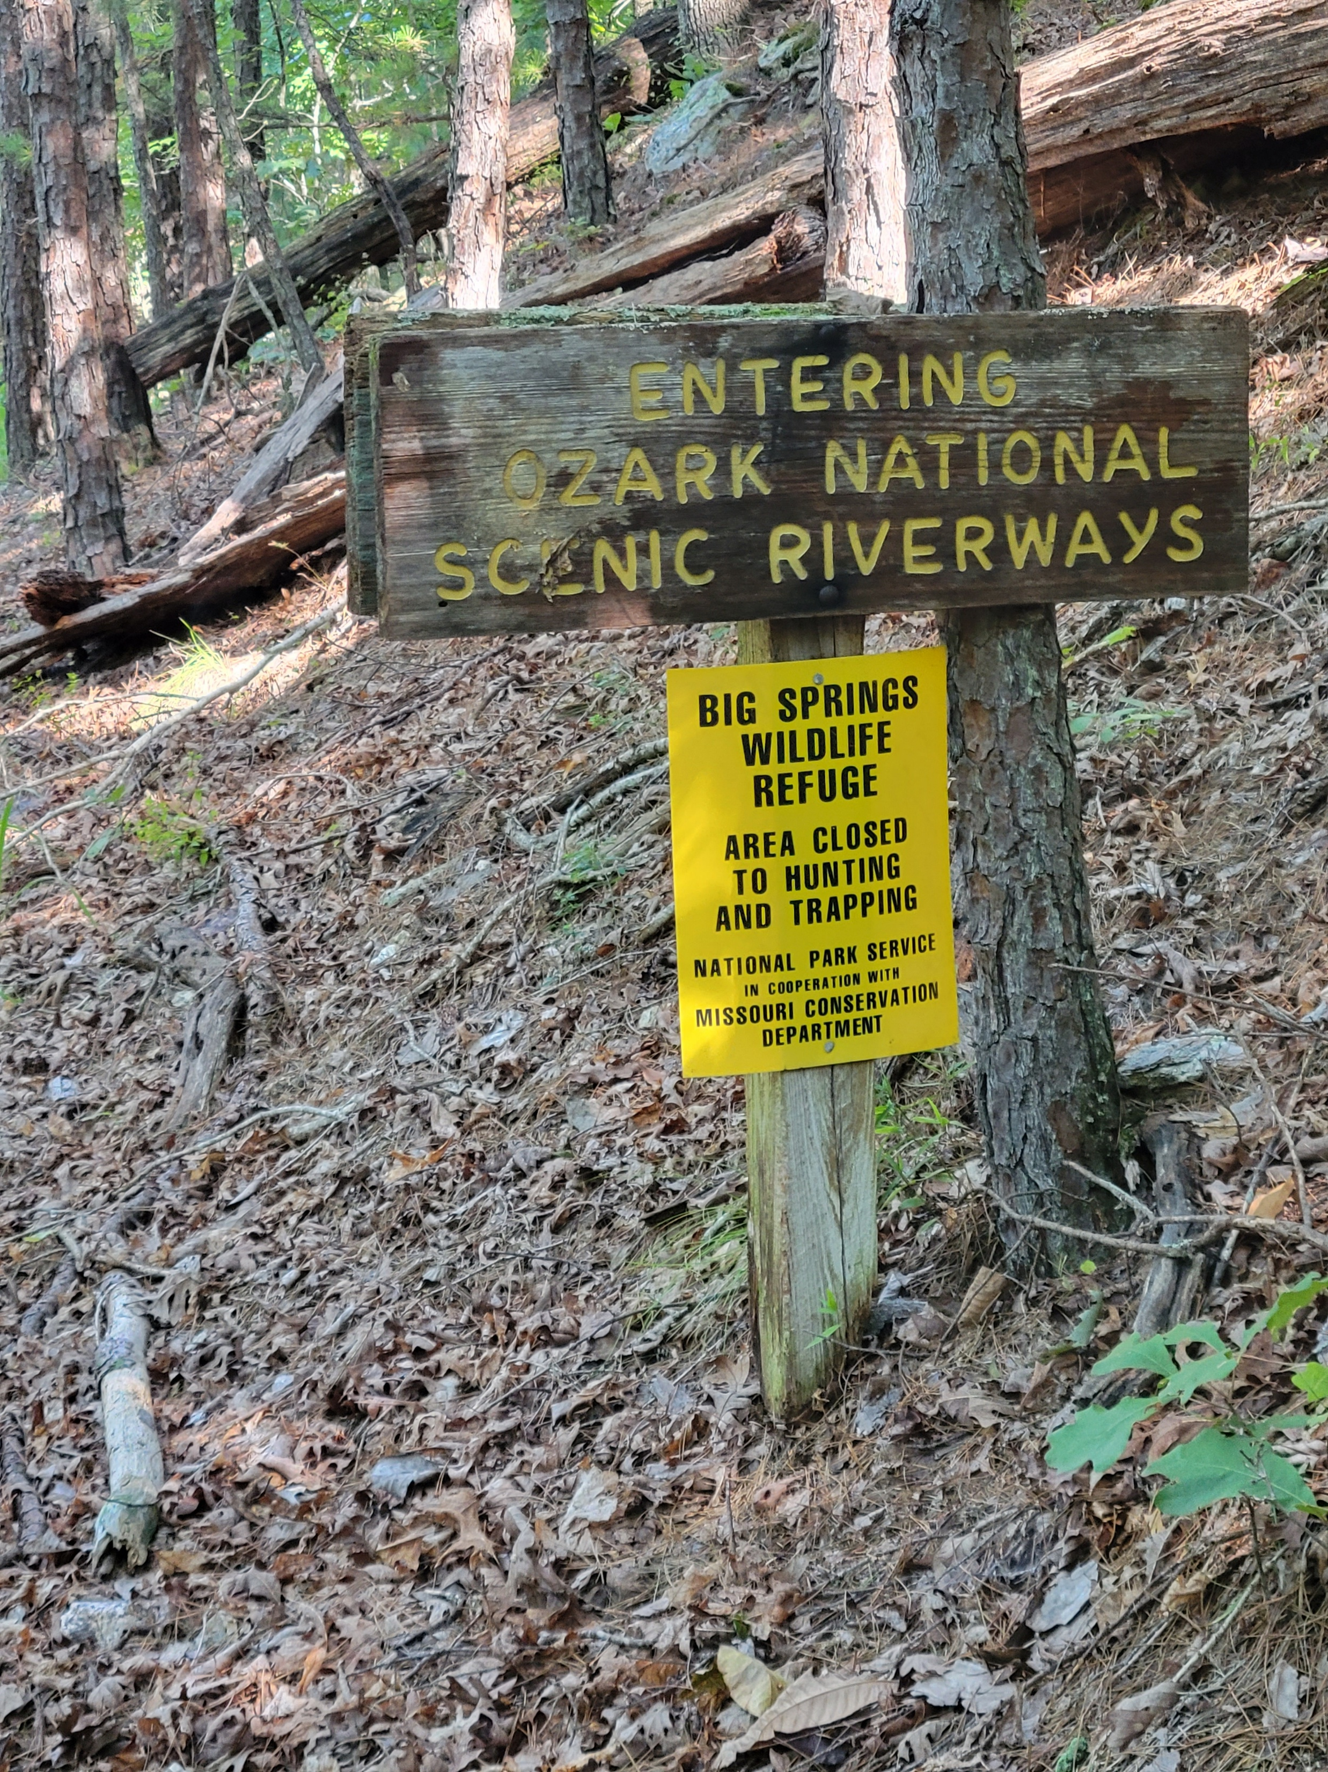
OTA
Construction and Maintenance
- Sawyers
- Trail Maintenance
- Equipment and Tool Maintenance
- Partners – Americorp, NCCC, MTB, HorseBack, USFS, LAD, Seirra Club, WaterShed Coalition
- Event Support ( Megas, WIUIW )
- Special ( City of St. Louis .. OFallon Park)
- Building South – OT-OHT Connection
- 2026 Calendar
– check www.ozarktrail.com/events
to get current events

Slide 6
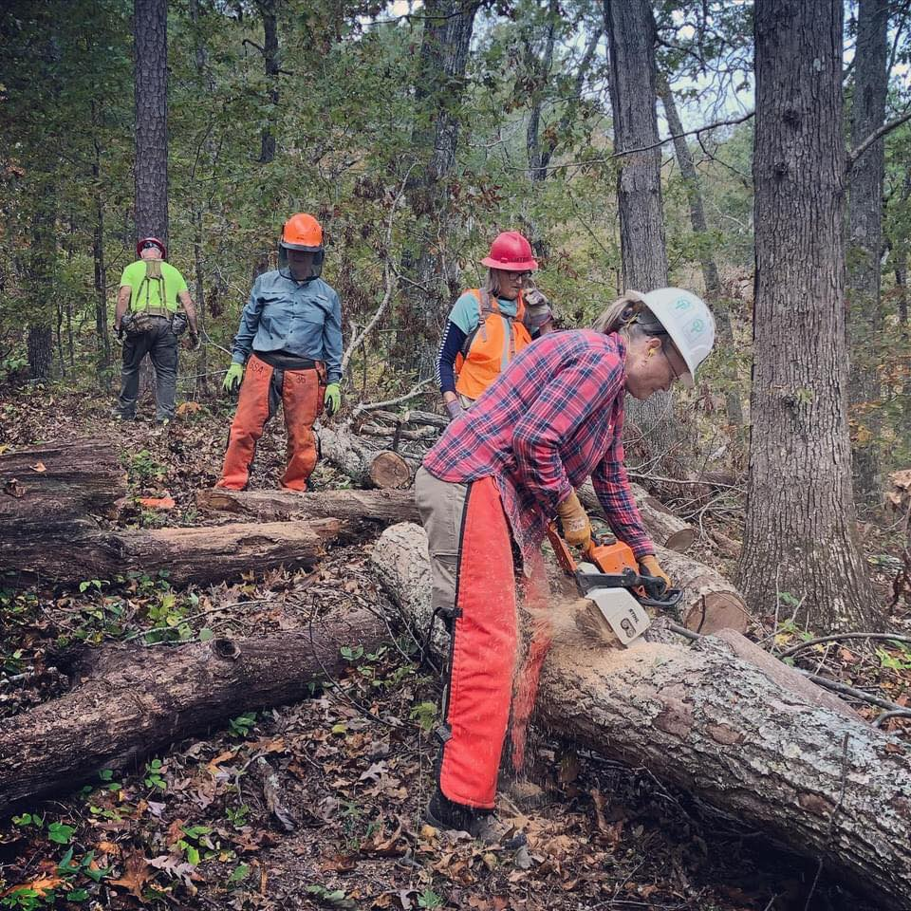
OTA
Maintenance 2025 - Sawyers
- Sawyer events – 30 sawyers certified in 2025
- Event Support – 31 scheduled
- Individual outings..
Wappapello, Victory
Karkahgne, Blair Creek
Current River, 11 Pt, BTR
Courtois, Trace Creek
Norfork, Taum Sauk
Marble Creek

Slide 7
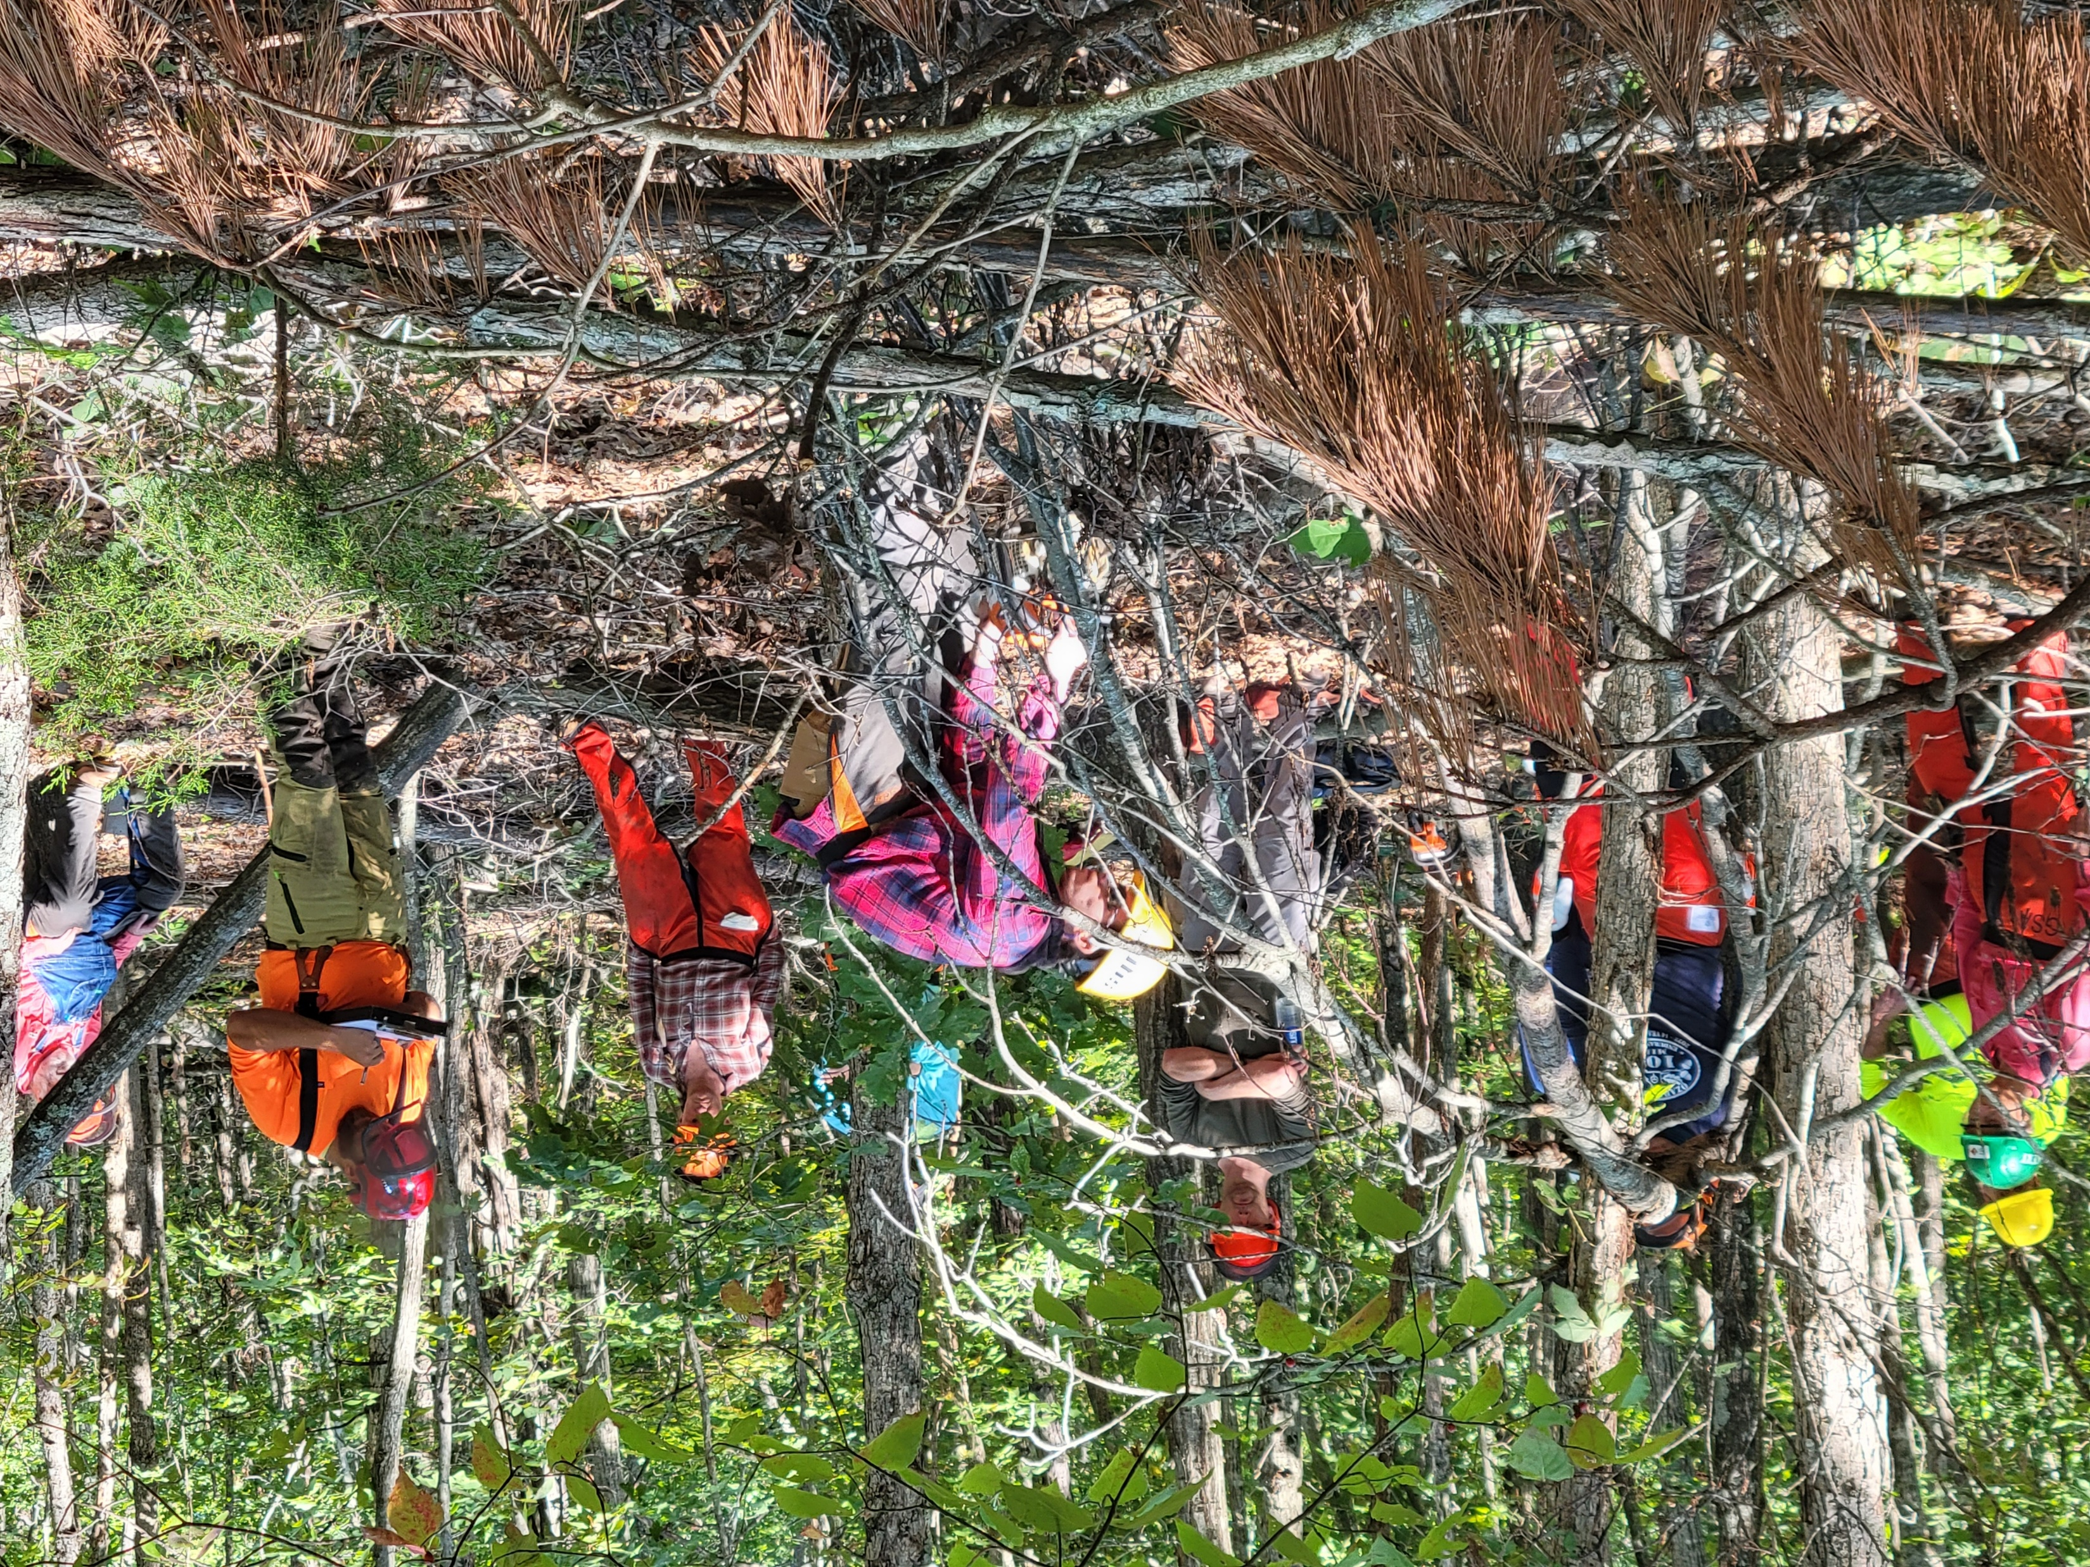
OTA
Maintenance - Training
- 2026 OTA USFS Chainsaw Cert
2 days Being Scheduled for Late Spring
- 2026 OTA UTV/ATV Training – TBD
1 Day
½ Day Classroom
½ Day Hands On Operation

Slide 8
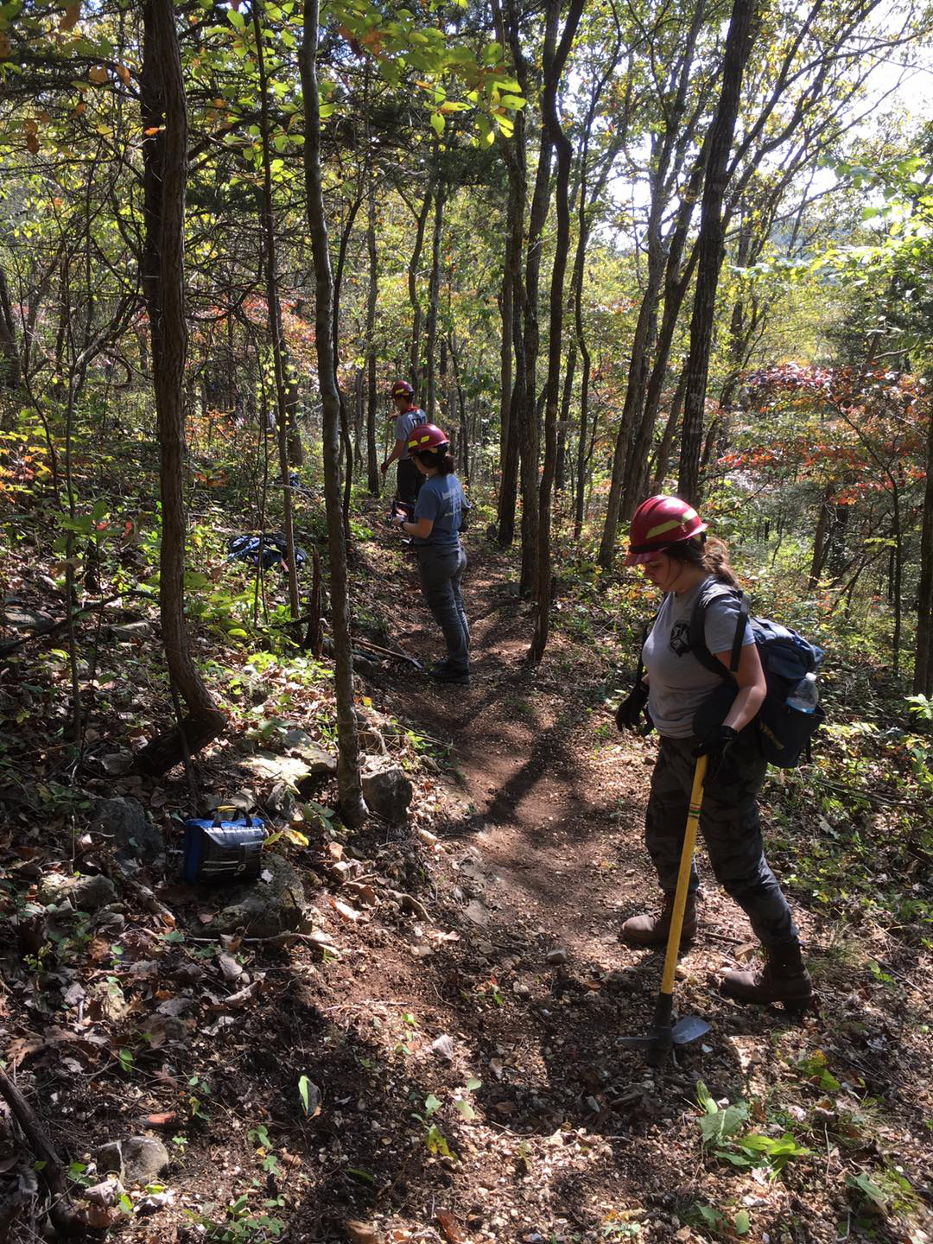
OTA
Maintenance - Americorp
6 Crews in 2025 (2 in Potosi and 4 in Winona/Peck Ranch)
GAOA Tread Repair
- All 14 Sections have had Tread Rehabbed
- 1000% ( 360 miles in MTNF has been assessed)
- Approx 70 miles of tread rehabbed to date
Sawing
- Courtois, Current River, BTR, 11PT,
-Upper Current River, Blair Creek
- Trace Creek, Victory, Marble Creek
    - Karkahgne
General Maintenance
Removing obstacles , lopping, leaf blowing
- All 14 sections

Slide 9
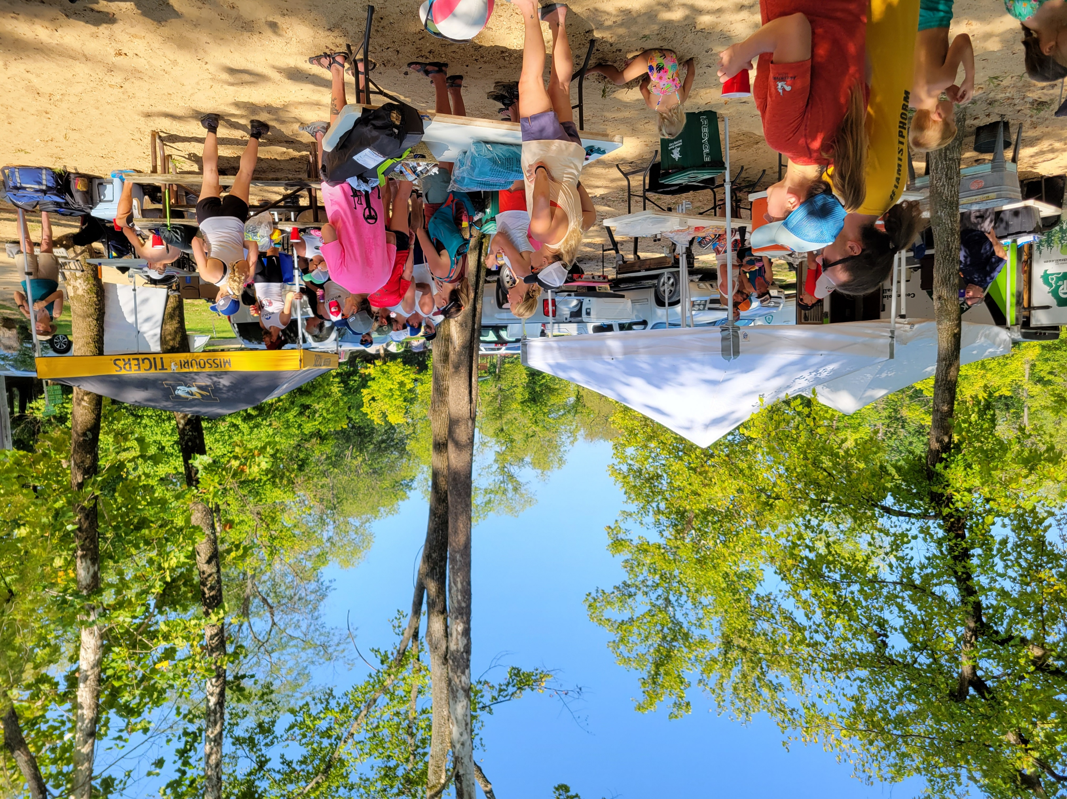
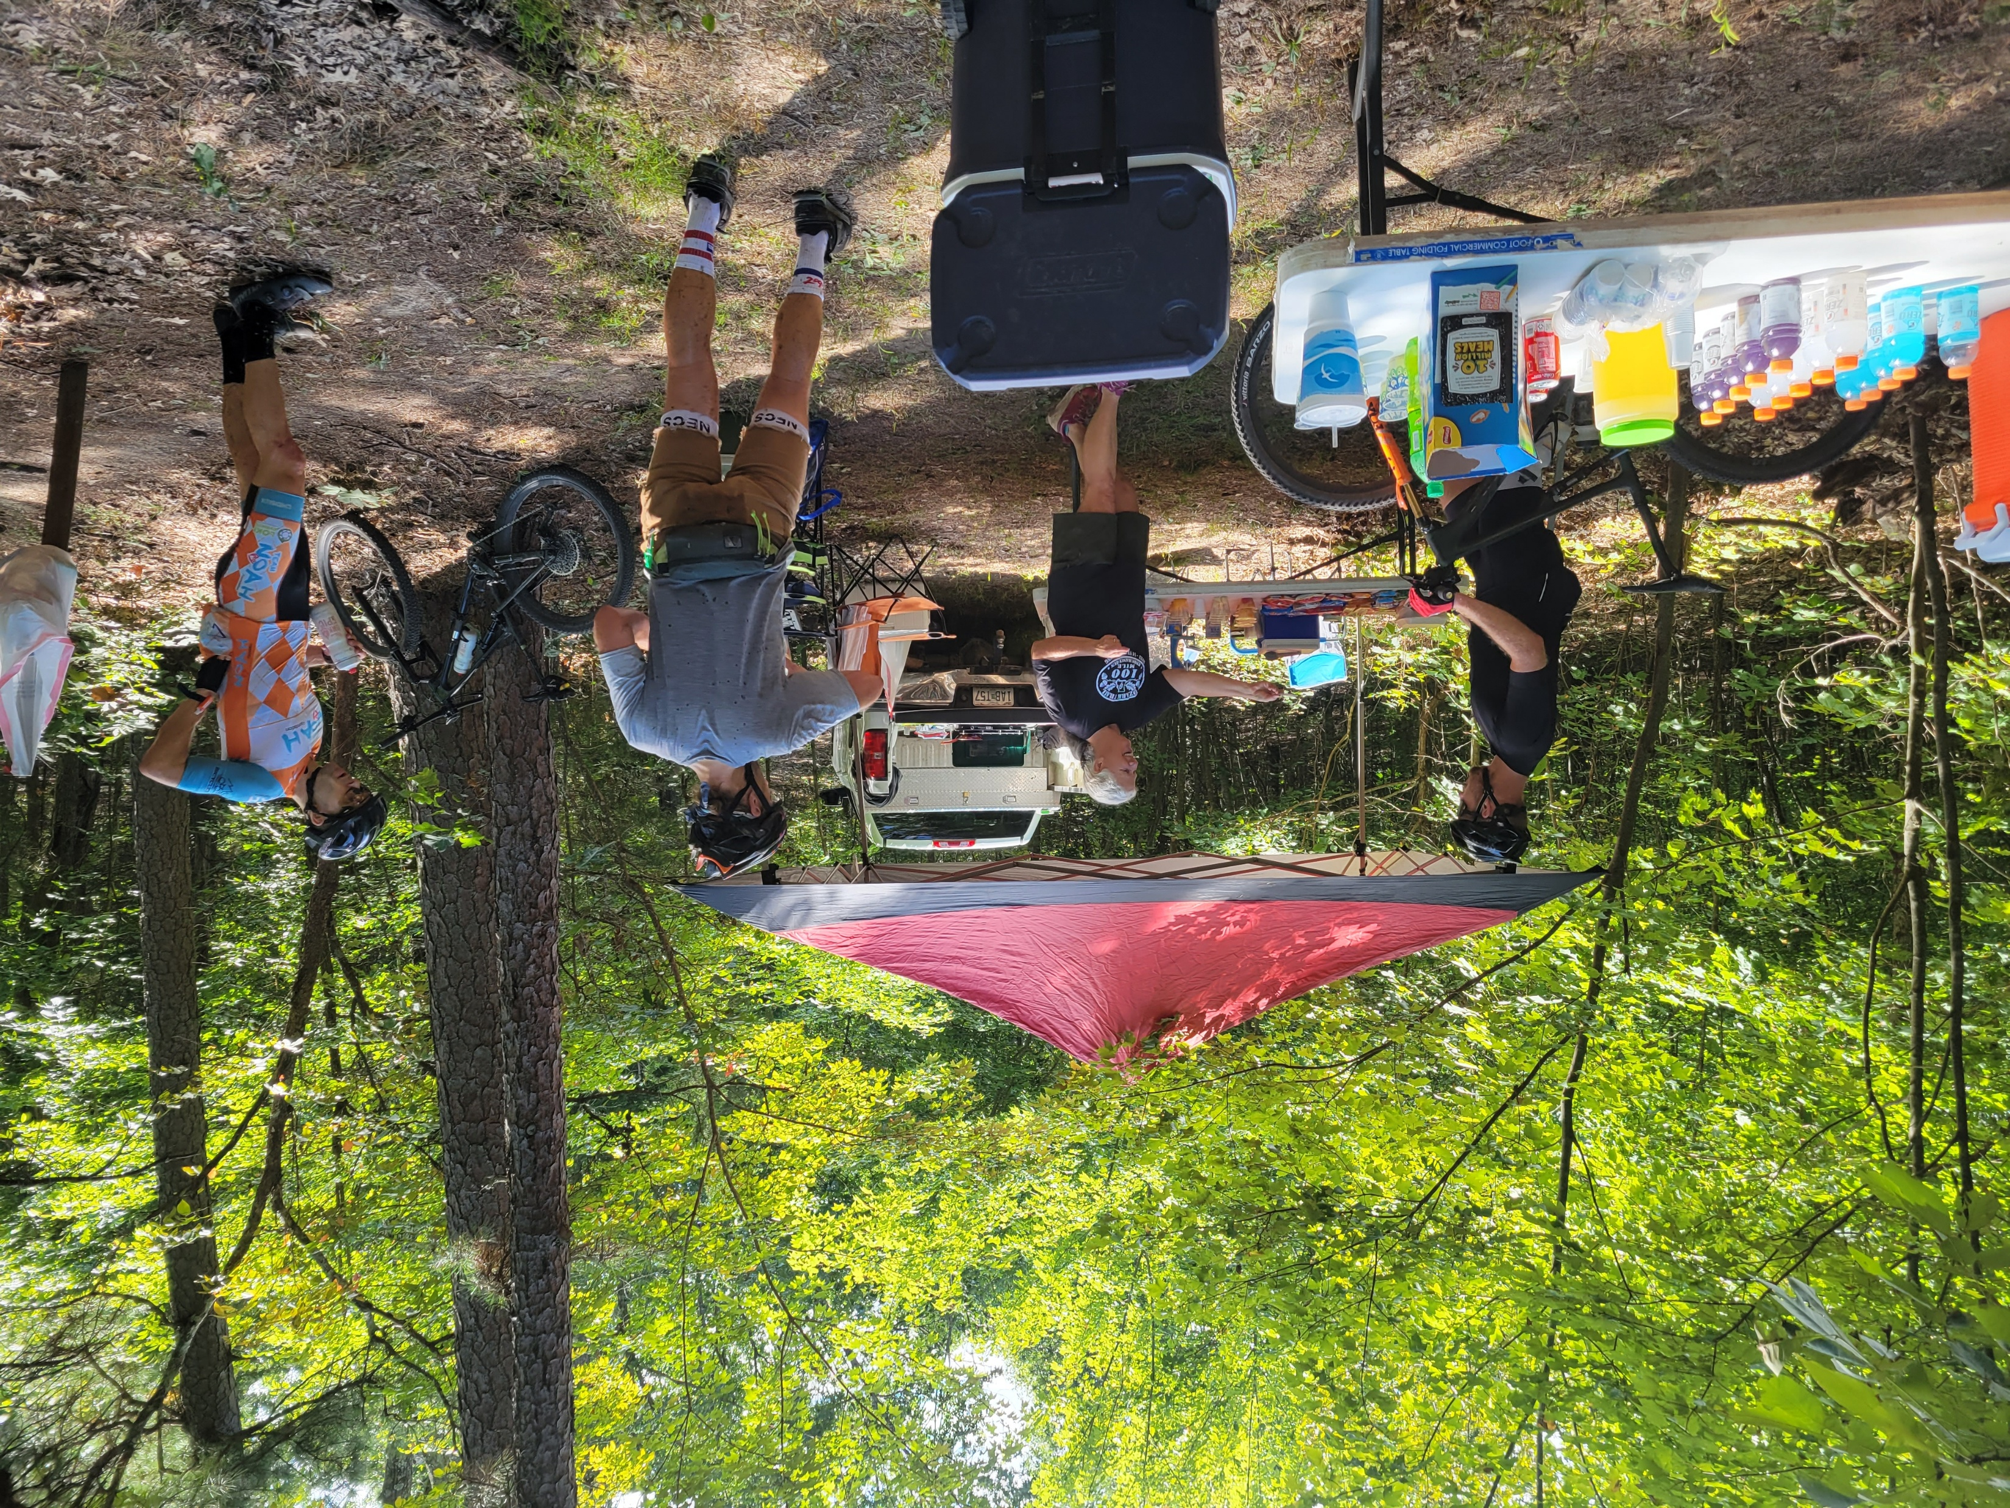
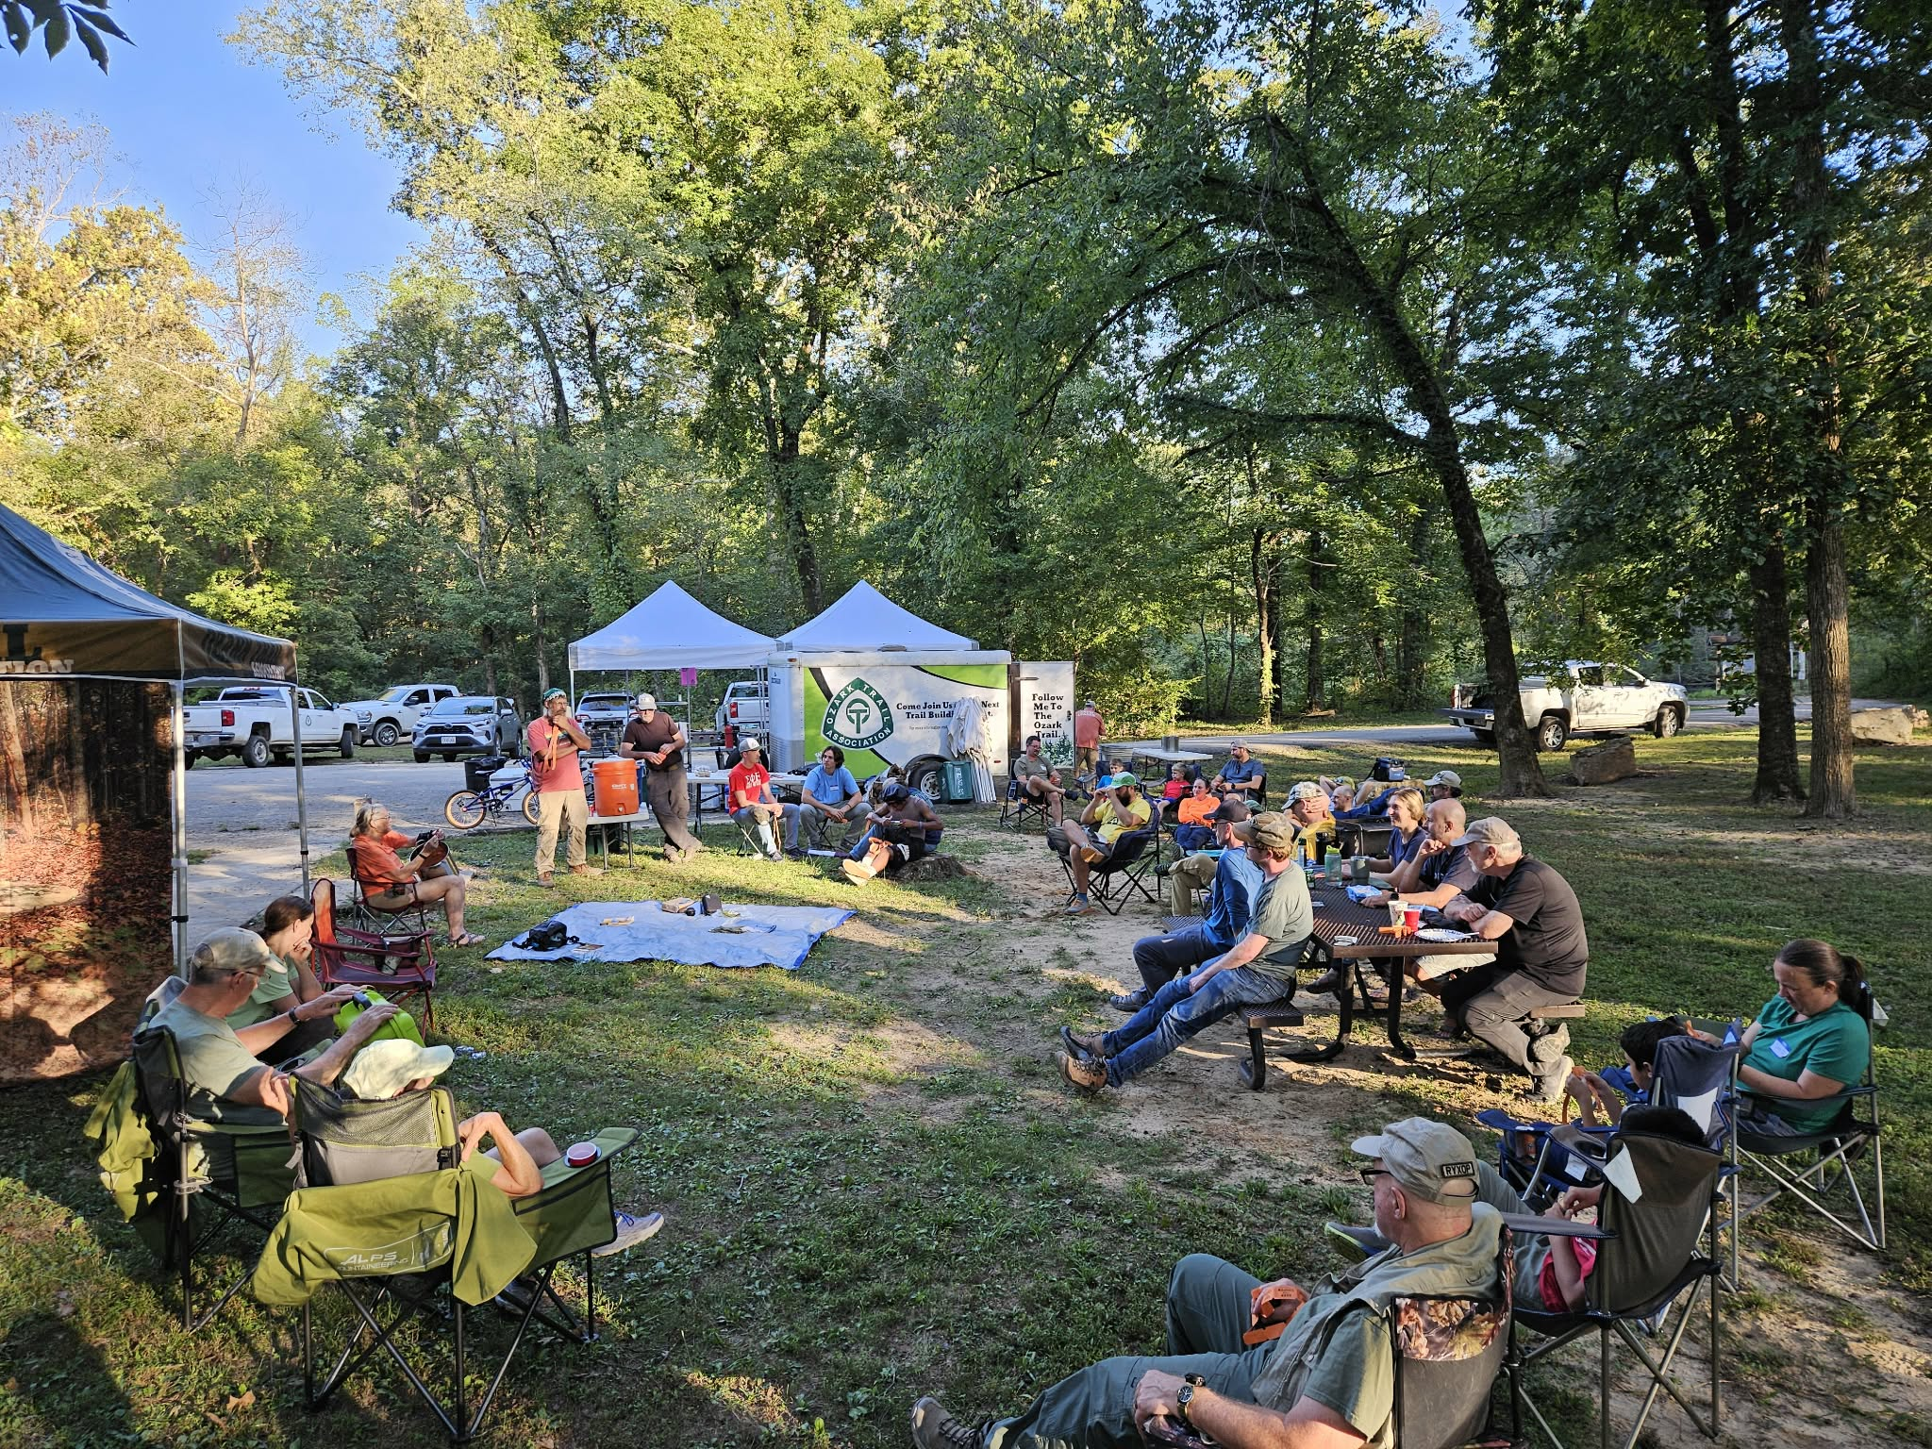
OTA – Event Support
With every event there is allways a maintenance day or more
3 Legged Monster Race
OT Challenge Hike
OTA Spring Mega
OTA Spring Whoopin It Up In Winona OTA Fall Mega
OTA Fall Whoopin It Up In Winona
OT100 Endurance Run
BT Epic MTB Race

Slide 10
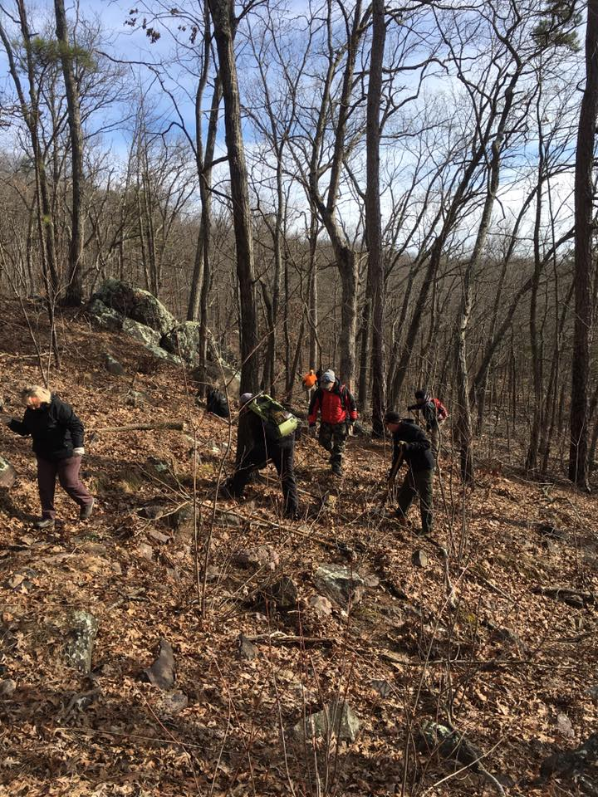
OTA
Trail Maintenance
Since 2021 over 140 Scheduled events ( 130 held)
Work Included:
- GAO Tread Repair
-Manual Lopping Weeds and Brush back from Corridor
- 3 Major Tornadic Storm Events hundreds of trees
Cleared – Blowdown from 2025 Storms still being cleared by USFS
-Removing obstacles from trail
-Weed eating / brush clearing/leaf blowing
with mechanical tools
- Adding/replacing new trail signage

Slide 11

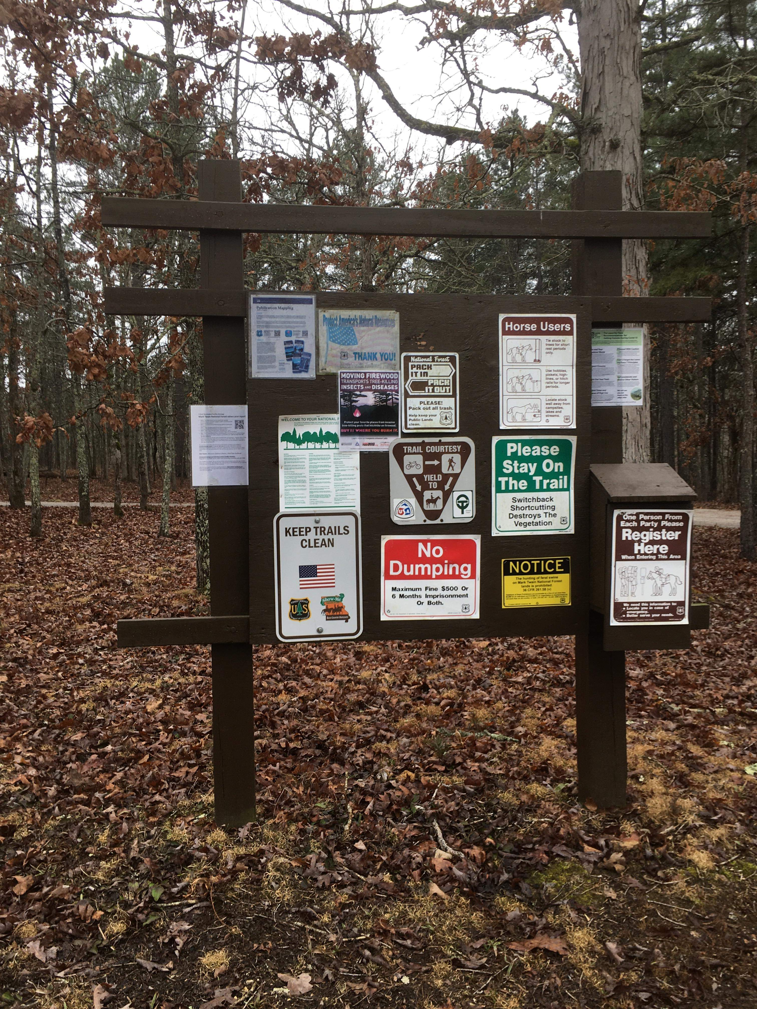
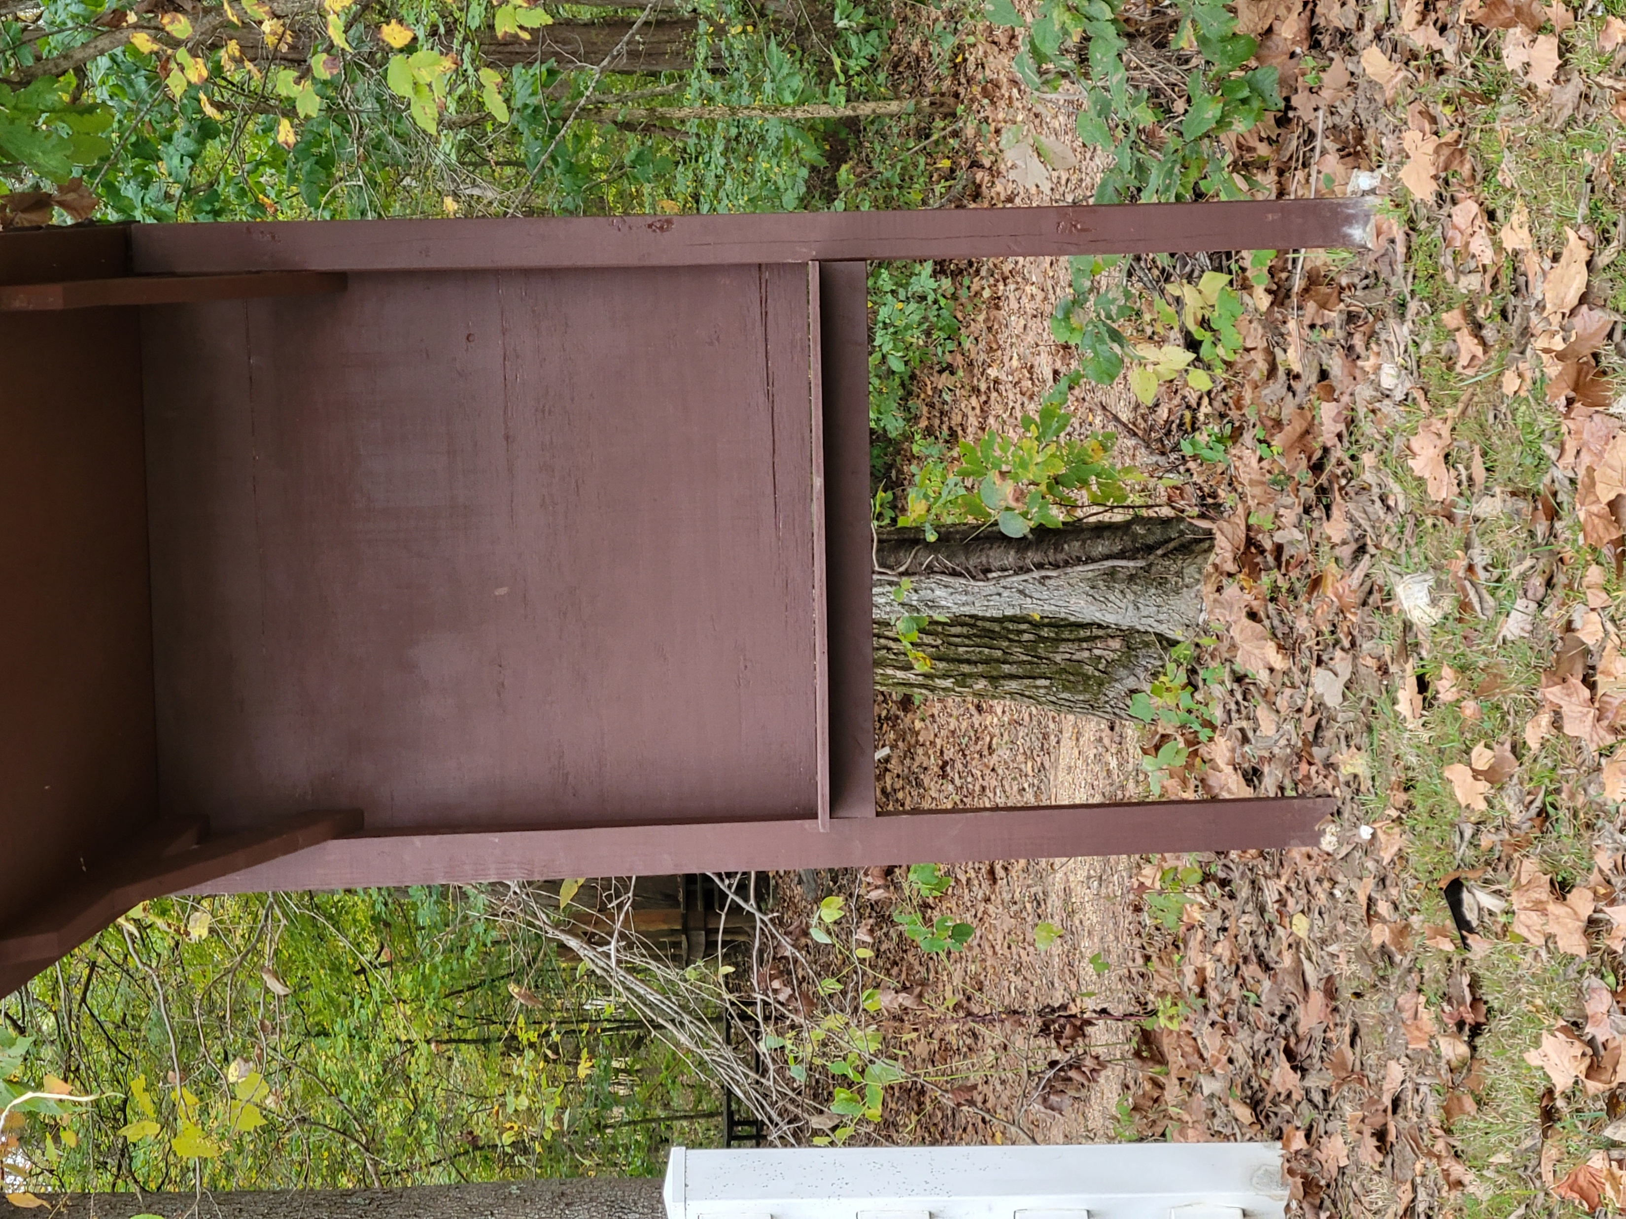
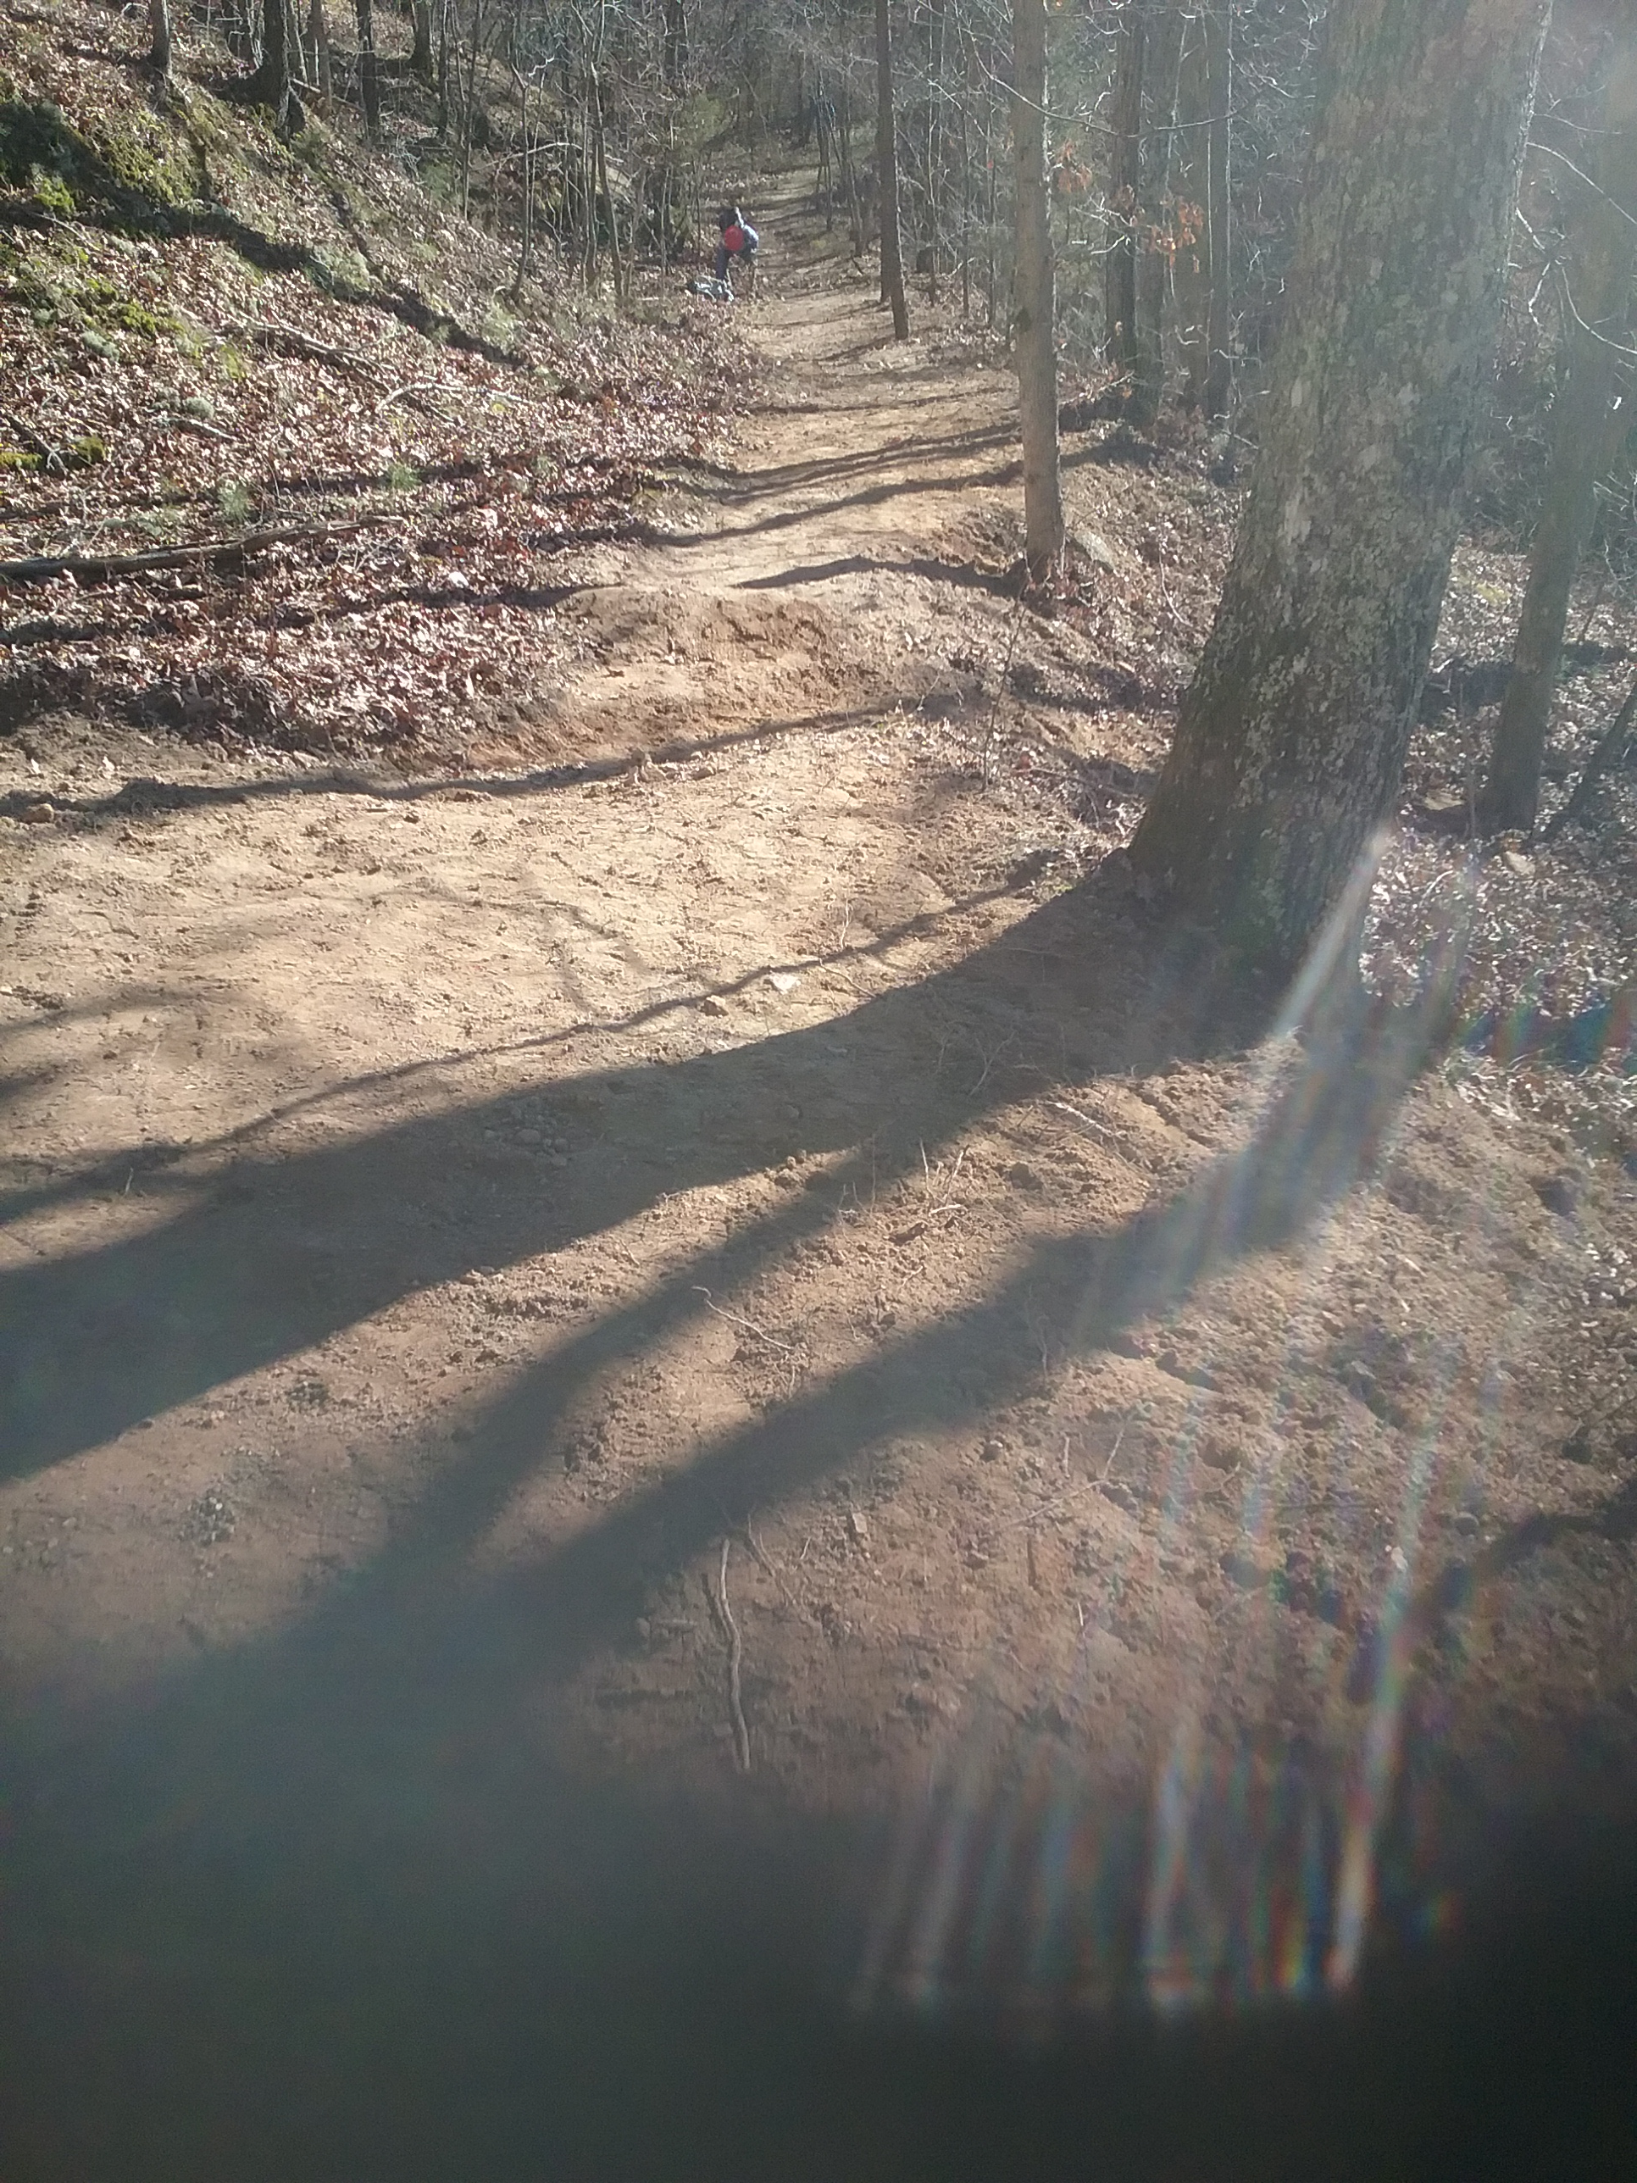
OTA
C and M Special Projects
4th Edition of
OT GuideBook
Delayed
Trail Head Upgrades
New Signage
New Sign-in Kiosks
New TrailHeads at Harmon Springs,
11 Pt and Wappapello
GAO
Tread Re-Hab
of Entire OT

Slide 12
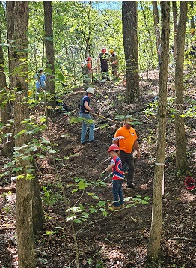
OTA
Feb 22, 2026 – GAOA Tread Rehab Status
Covered Approx ( All 364) miles in MTNF assessed with approx 70 miles of tread re-habbed (over 120 GAOA events since May- 2021 thru April 30, 2025 extension contract signing). We signed a new 3 year GAOA contract with the USFS effective Sept 1, 2023 and runs through Aug 31, 2025. The Contract was extended through Sept 1 2026.We have had over 60 GAOA events under the new 2023-2026 contract to date.
- Courtois Section *, Trace Creek *
- MiddleFork, Karkahgne *, Current River,
- Blair Creek, Between the Rivers *
- Eleven Pt *, Victory Section, North Fork
* Most work done in critical areas

Slide 13
2026 C & M Schedule
To see the current 2026 OTA Calender go to
https://ozarktrail.com/events/

Slide 14
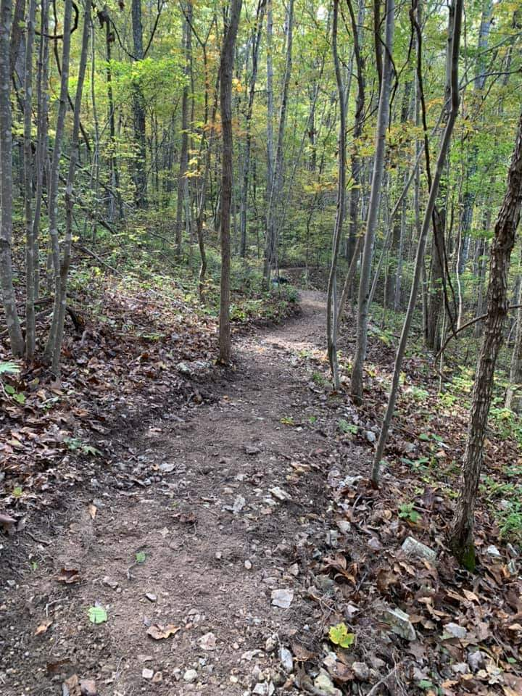
OTA
Guardians of the Ozark Trail For All

