Slide 1

Trail Planning and Development

Slide 2
Trail Planning and Development
The TP&D Committee leads the OTA efforts to connect the gaps and complete the Ozark Trail. We are:
Developing future trail routes and trail design with the vision of the trail extending from St Louis to the Arkansas border and connecting with the Ozark Highland Trail.
Leveraging geospatial technology to plan and design new trail corridors and track our planning and development efforts.
Engaging with local community and government leaders, landowners, and land managers to obtain the rights and permission to enable us to construct new trails.
Partnering with other OTA committees to obtain funding to secure these rights.
The OTA, Van Buren Trail Coalition, and the Poplar Bluff Trail Coalitional have been selected for the inaugural cohort of the TrailNation Accelerator, a national program led by Rails to Trails Conservancy supporting rural and small-town trail networks.
Over the course of the year-long program we’ll work with RTC and other cohort teams across the county to align vision, resources and collaboration strategies. We’re taking the next steps to advance trail connectivity in the region and create lasting benefits for residents and visitors.

Slide 3
Trail Planning and Development
Committee Members
Jim Schneider – Chair
Ashley Newson – NPS
Drake Deasley
Matt Aholt
Jack Waterbury
Roger Allison - Treasurer
Mark Goforth - VP

Slide 4
Trail Planning and Development
Gaps on the Backbone include:
  Meramec River Greenway to Courtois Section TH at Onondaga State Park - 50+ miles
  Eleven Point to North Fork – 37+ miles
  North Fork to Dawt Mill – 16+ miles
  MO / ARK Border to Dawt Mill – Corp of Engineer Land - 15 miles
Other Gaps:
    Ketcherside Mt to Marble Creek – 10+ miles
    Marble Creek to Sam A Baker – 15+ miles
    Victory to Wappapello – 4+ miles
    Between the Rivers and Victory – 30+ miles

Slide 5
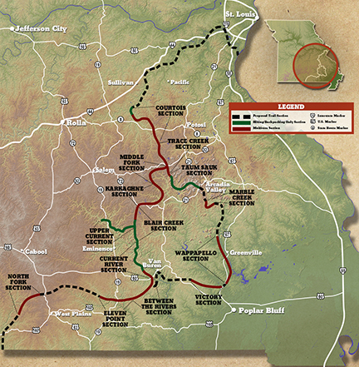
The Ozark Trail
Areas of Focus

