Slide 1

Ozark Trail Association
Our mission: to develop, maintain, preserve, promote, and protect the rugged, natural beauty of the Ozark Trail.

Slide 2
Ozark Trail Association
Grass-roots nonprofit volunteer group dedicated to the construction, maintenance and promotion of the Ozark Trail
501(c)(3) Nonprofit Corporation since 2002
  Board of Directors
  Corporate Officers

Slide 3
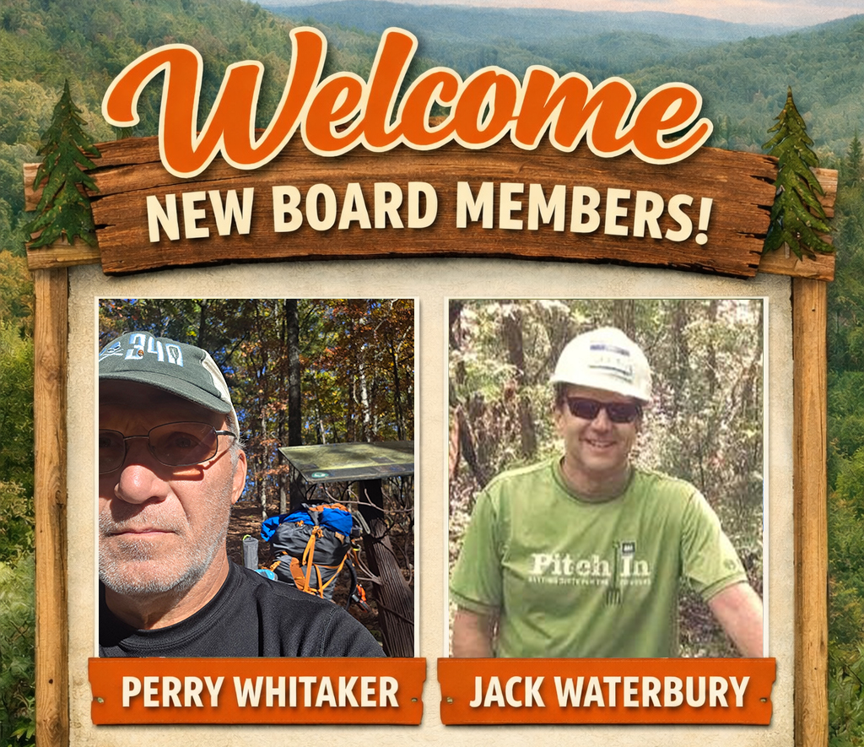

Slide 4
OTA Board Members
Kathie Brennan
Mark Goforth
Garrett Doak
Roger Allison
Jim Schneider
Steven Bossman
Michael Pearce
Jack Waterbury
Perry Whitaker

Slide 5
OTA Employees & Officers
Abi Jackson, Chief Operations Officer
Devin Barnett, Trail Crew Leader
Michael Pearce, President
Mark Goforth, Vice President
Roger Allison, Treasurer
Steven Bossman, Secretary

Slide 6
On-Trail Volunteer Opportunities
Trail Building & Maintenance Events
    https://ozarktrail.com/events/
Adopt-A-Trail Program
Roving Adopter Outings
Sawyer Outings
Join Devin, OTA’s Trail Crew Leader

Slide 7

Staffing the Organization
Construction & Maintenance
  Event Leaders/Coordinators
  Adopt-A-Trail Coordinator
  Tool Manager
  Chair & Vice Chair
Education & Outreach
  Adventure Ambassadors

Slide 8
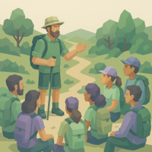
Education, Promotion
Online Educational Resources
  How To Guides
Social Media Promotion
  Section Highlights
  Trail Users
  Adventure Ambassadors

Slide 9
2025 Volunteer Awards

Slide 10
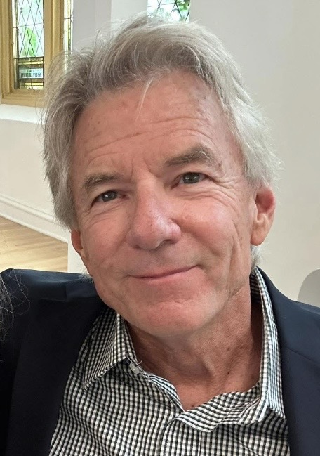
Volunteer of the Year
Michael Chapman
Mike is a skilled sawyer and trail builder whose frequent volunteer efforts helped keep the trail open after the Spring 2025 tornadoes. He is dependable year-round, performing crucial trail maintenance during peak seasons. The OTA is very thankful for Mike’s dedication.

Slide 11
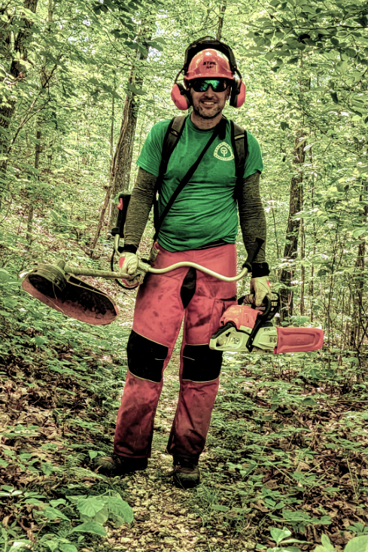
Maintainer of the Year
Joe Lyons
Joe submitted work reports for 17 different maintenance outings during 2025. This includes work as a trail adopter, a sawyer, and other maintenance activities. Joe’s consistent dedication throughout the year is a huge part of what makes the trail accessible
to everyone.

Slide 12
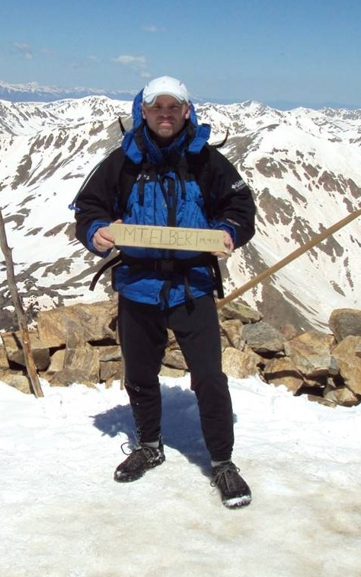
Adopter of the Year
James Mercer
James Mercer and co-adopter Andrew Karandjeff adopted 4 Karkaghne segments and 2 Taum Sauk segments in 2025. The total of the 6 segments in length is 21.5 miles. James’ work on the Karkaghne goes back several years. His total 2025 adopter work hours on the trail was 40.75. How does he do it? He has finished the Ozark Trail 100 mile endurance run at least twice, finishing as high as 7th overall.

Slide 13
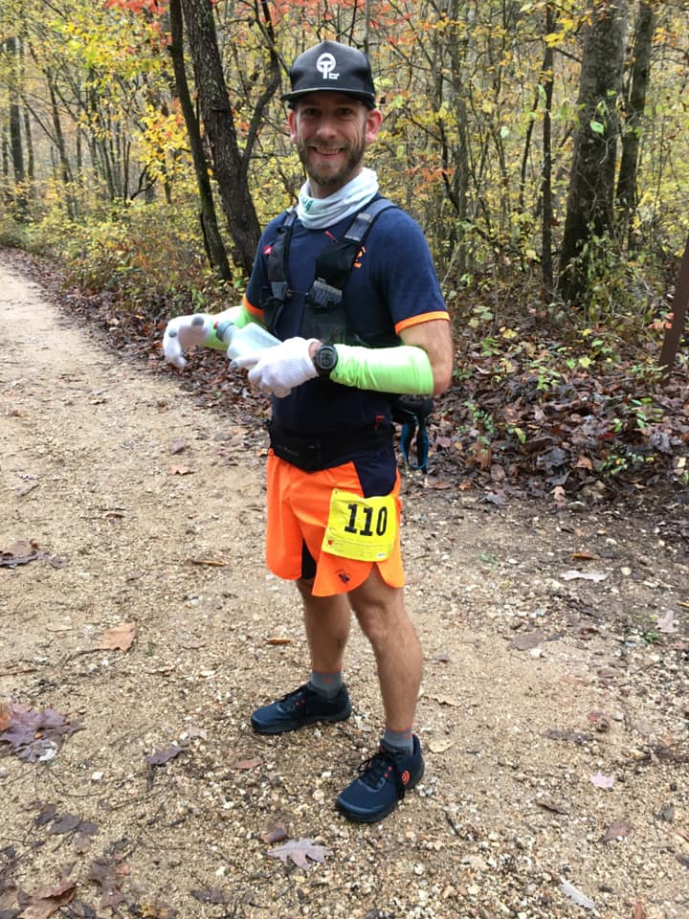
Race Director Award
Jake Grossbauer
Jake is a four-time finisher of the Ozark Trail 100 Mile Endurance Race, a trail adopter, a former OTA Board member, and has served as Race Director for the Devil’s Toll Race for seven years. We are incredibly grateful for Jake’s time, dedication, and volunteer spirit.

Slide 14
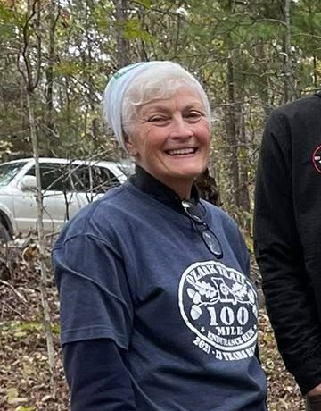
Backbone Award
Andrea Yates
Andrea is consistently willing to step up to serve anywhere she is asked. In addition to her AAT and trail maintenance work, she worked several events, including providing supplies for aid stations for the 3-Legged Monster Adventure Race

