Slide 1

Finance Committee
  Committee Responsibilities:
    Financial Reporting, Internal and External
    Budgeting
    Developing long range financial plans
    Developing fundraising strategy
  Committee Membership:
    OTA Treasurer, Roger Allison
    Membership Coordinator and Board Member, Garrett Doak
    Board Member Planning Chairman, James Schnieder
    Michael Pearce, OTA President, Ex-Officio

Slide 2
OTA Revenue 2024
As reported on 2024 Form 990
Total Revenue $241,595.00

Slide 3
OTA Functional Expenses 2024

Slide 4
Functional Expenses

Slide 5
OTA Financial Position
OTA Total Assets
Notes
Year | Jan 1 | Dec 31 | Change
2023 | $231,811 | $242,832 | $11,022
2024 | $242,832 | $253,453 | $10,621
2025 | $253,453 | $251,572 | -$1,881
Total Assets consist of checking account, OTA Reserve fund (CD’s), book value of vehicles less depreciation and OTA Endowment fund at market value.

Slide 6
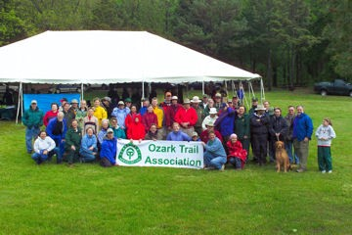
Questions?
OTA financial documents are available at:
https://ozarktrail.com/resource-center/

