Slide 1

Community Outreach and Education
Cathy Renth

Slide 2
Accomplishments
Developed goals to align with the OTA mission
Established core committee membership
Alpine Pint Night
Van Buren Outreach
Co-Worker appreciation event
Bass Pro Event

Slide 3
Goals
Promote and enhance awareness of the Ozark Trail and the Association
Expand our outreach to traditionally underserved communities
Expand outreach to target youth and young adults
Integrate new members and engage existing members and volunteers to enhance their on-trail and off-trail experience
Build a cadre of volunteers to support programs and activities

Slide 4
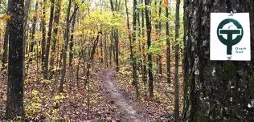
2026 Plans
Collaboration with MDC/Powder Valley: Exploring the OT- April 16
Alpine Shop/OTA Pint Night: September 24
Continued outreach in Van Buren
Connect with youth organizations
Develop a “Welcome to the OTA” program for new members

