Slide 1


OTA Adopt-A-Trail Program 2025 Membership Report

Slide 2
OTA AAT program had strikingly similar results in 2025 compared to 2024.
On the positive side, new adoptions increased 12% from 16 in 2024 to 18 in 2025.
On the negative side, report totals dropped 8% from 169 in 2024 to 155 in 2025.
To put this in perspective, a selected cohort of three adopters provided a combined total of 36 reports in 2023, 36 reports in 2024, but only 3 reports in 2025.
There were only 8 new adopters in 2023, however, there were 212 reports.

Slide 6
The table above reveals what program areas need to be continued in 2026 to deal with these statistical conundrums:
Recruiting volunteers to fill open segments, particularly in the southern sections of the trail where generating local interest can help carry the workload of maintaining the trail.
Use of social media to promote the Adopt-A-Trail program. (i.e., pertinent Facebook groups). This was tried late in 2025 and resulted in several adoption inquiries.
Consider incentives besides T-Shirts and awards for participation and retention of adoptees
Creating training opportunities and workshops for potential and current adopters.
Making tools and equipment available to adopters in all areas of the trail.

Slide 7
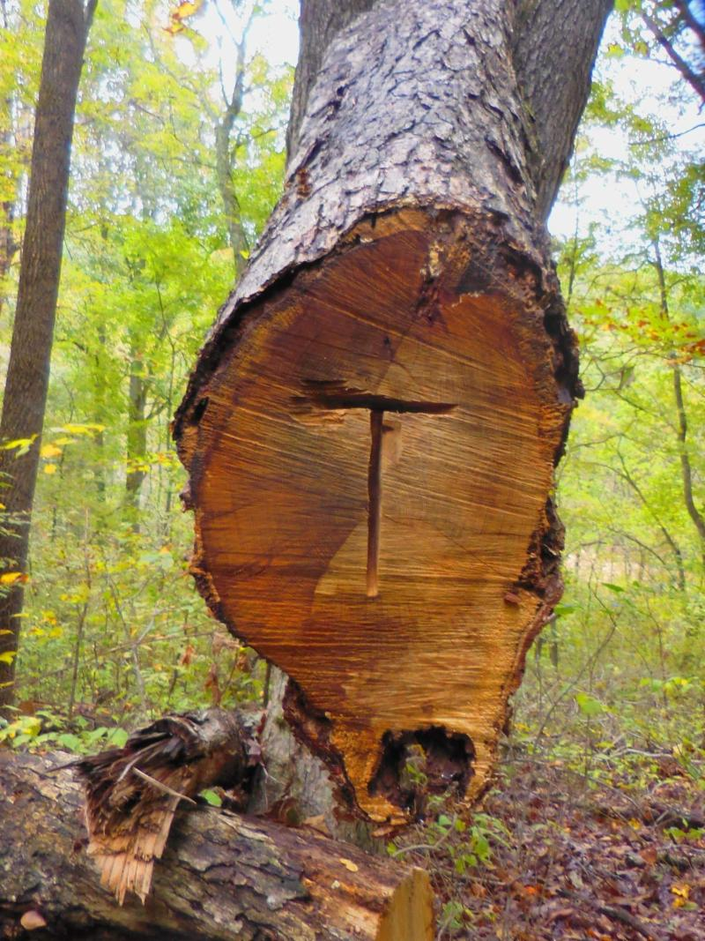
LOOKING AHEAD
8 NEW AD0PTERS SIGNED UP JANUARY 1, 2026 TO FEBRUARY 20, 2026
Can the AAT program reach 20 new adopters for 2026?
4 MORE REPORTS (as of February 2026) than in 2025 (as of same date).
Can the AAT program reach 200 reports in 2026?

